Slide 1
Satellite Communication Systems

Slide 2
05 Application

Slide 3
Modern society relies on exceeding number of services provided through satellites
Many thousands of satellites have been launched for a wide range of different purposes, including:
Scientific satellites
Scientific satellites provide space-based platforms to carry out fundamental research about the world we live in, our near and far space
Earth observation
Earth Observation (EO) is the process of gathering information about the Earth’s surface, waters and atmosphere via remote sensing platforms
Military surveillance
Military satellites are an essential component of modern warfare, providing crucial intelligence, communication, and surveillance capabilities to military forces
Communications (civil and military)
Satellite communication is the use of artificial satellites to provide communication links between various points on Earth
Navigation
Global Navigation Satellite System (GNSS) refers to any satellite constellation that provides global positioning, navigation, and timing services

Slide 4
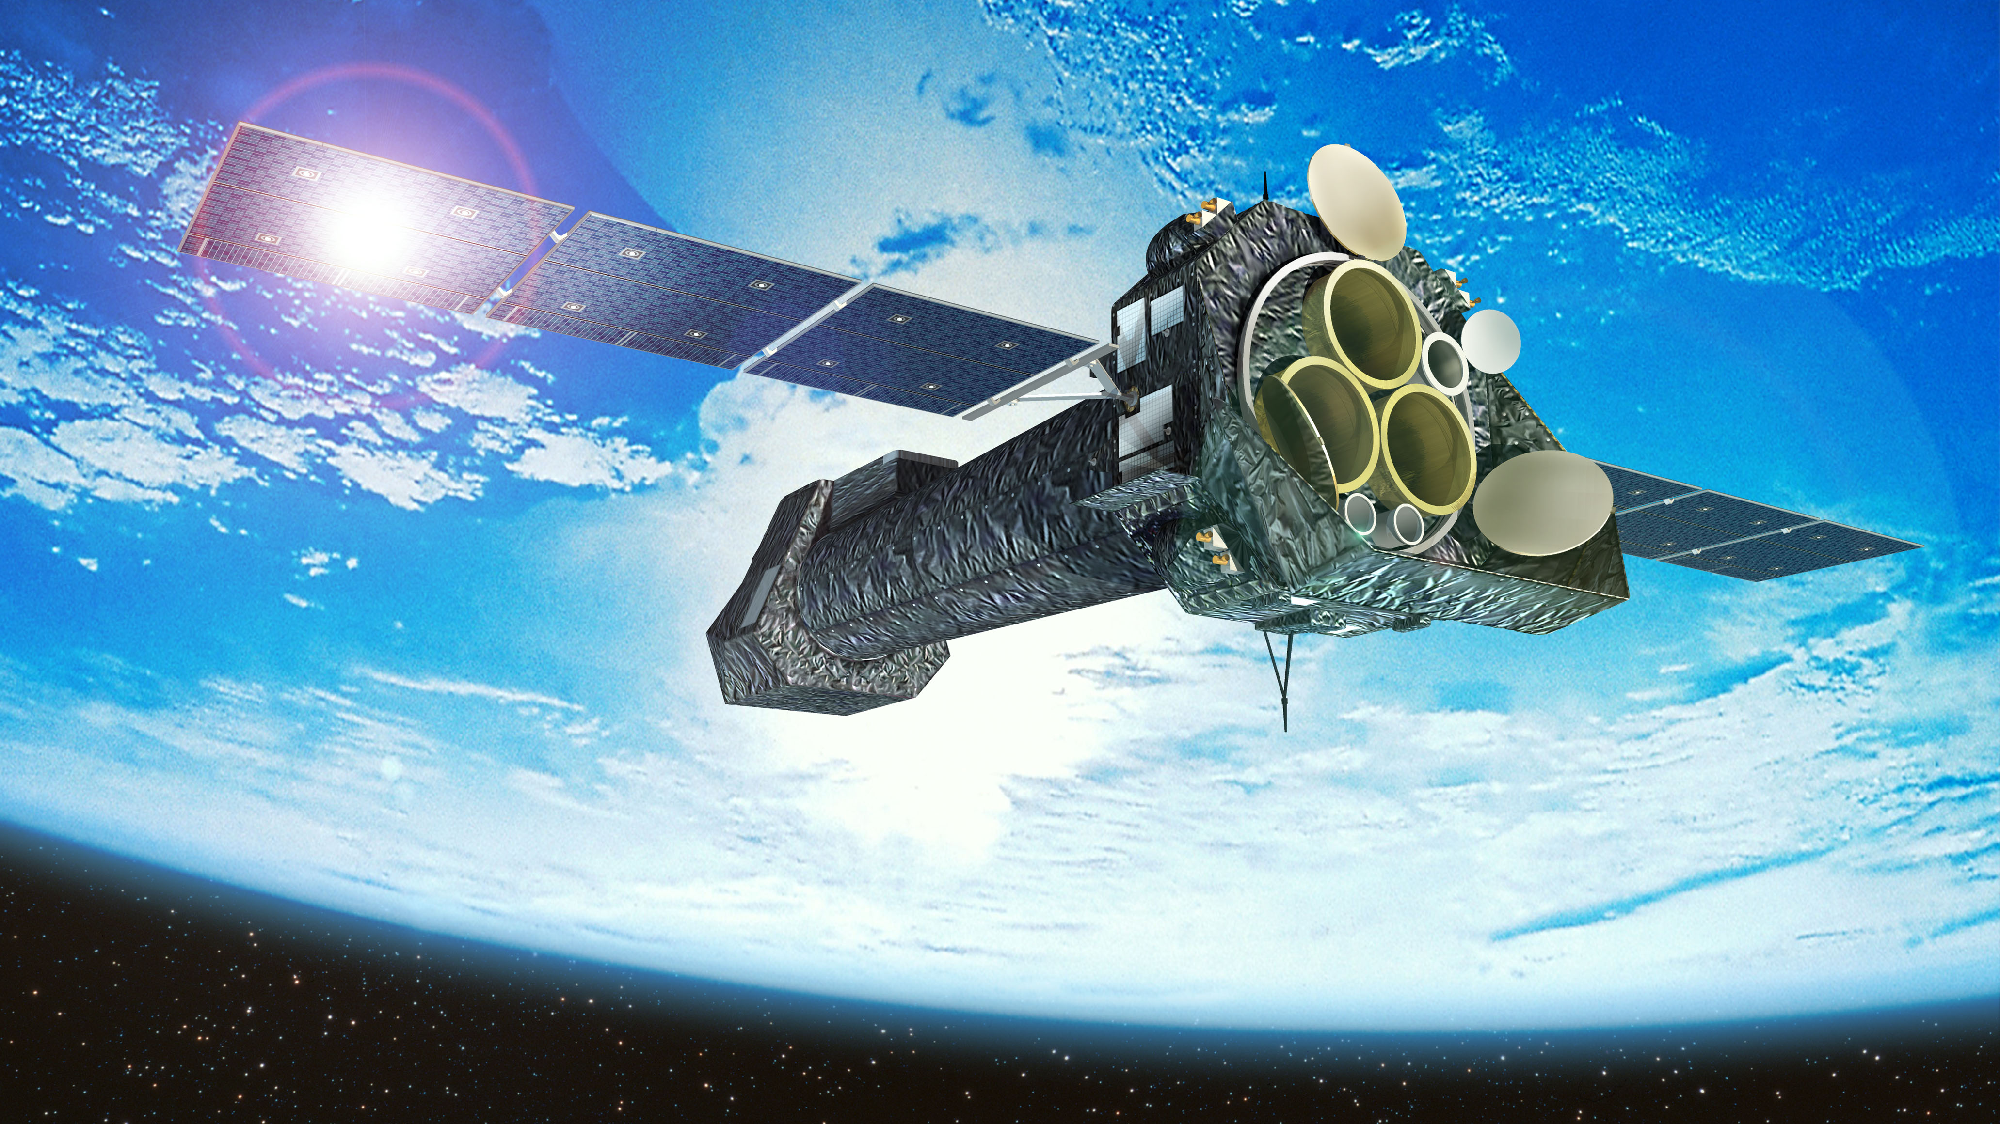
Scientific satellites
Image credit: ESA

Slide 5
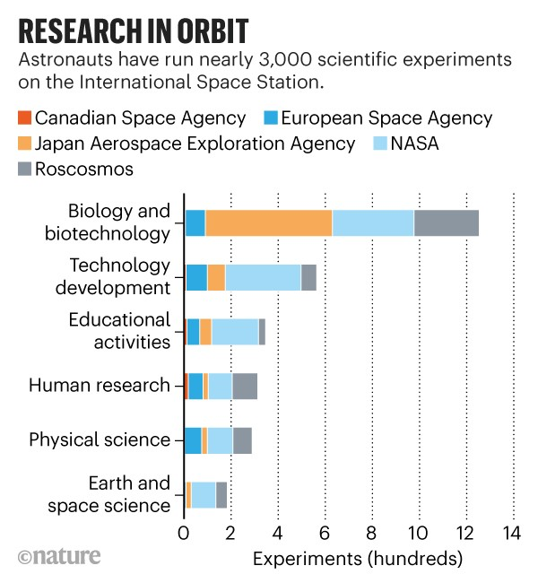
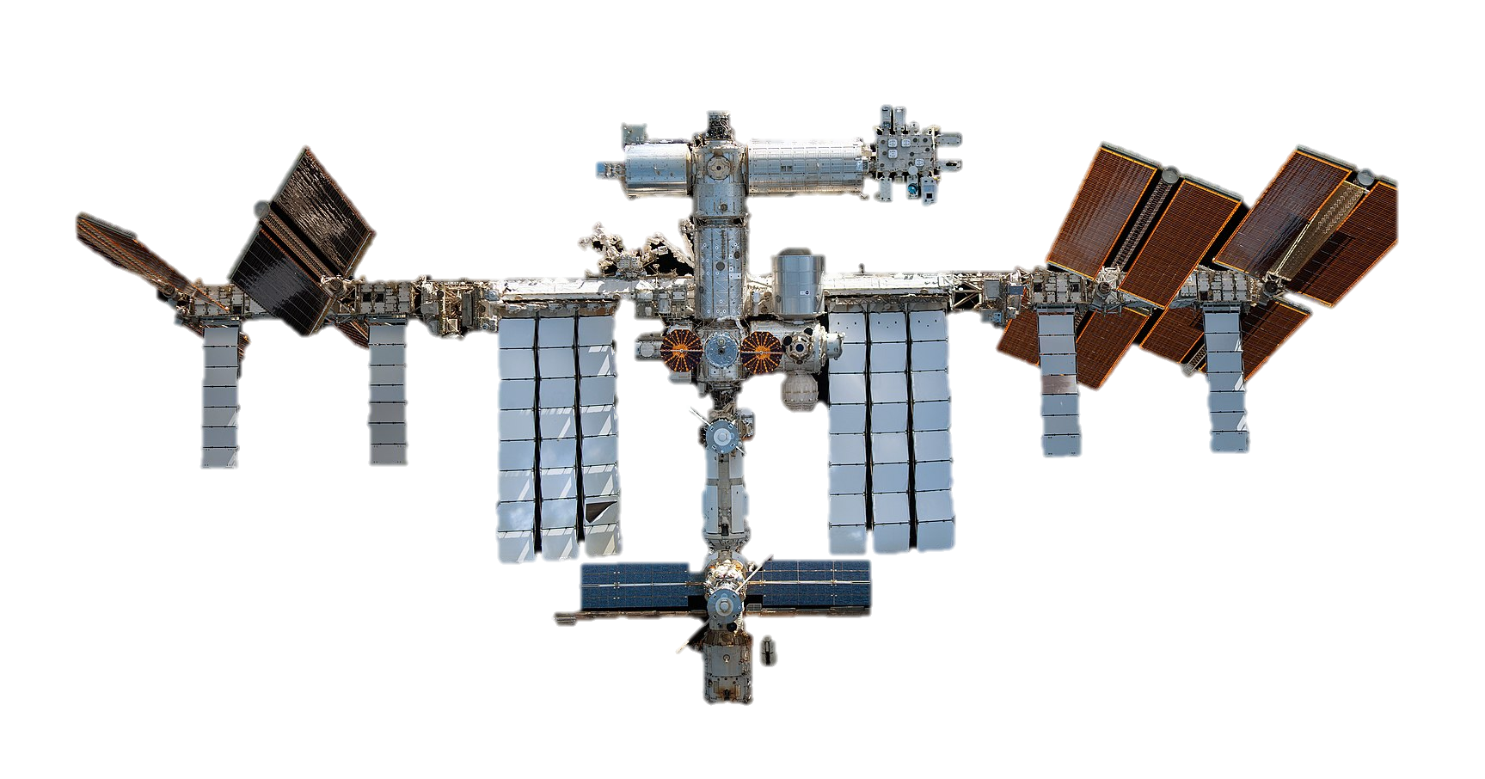
Scientific satellites provide space-based platforms to carry out fundamental research about the world we live in, our near and far space
It includes:
magnetic fields,
space radiation,
Earth and its atmosphere,
the Sun or other stars,
planets and their moons,
and other astronomical objects and phenomena.
Source:
https://www.nature.com/articles/d41586-020-03085-8

Slide 6
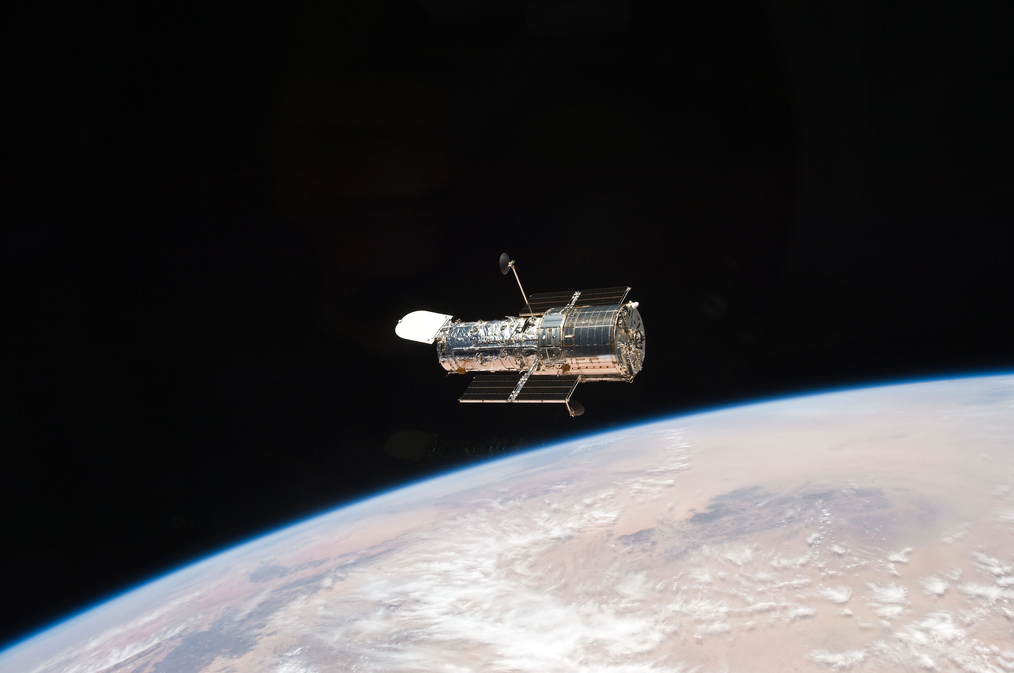
Since its 1990 launch, the Hubble Space Telescope has changed our fundamental understanding of the universe
Orbiting high above Earth's obscuring atmosphere, NASA's Hubble Space Telescope’s multiwavelength capabilities let it capture ultraviolet, visible, and near-infrared light. This unique ability allows astronomers to not only see a wide range of cosmic phenomena but also lets them focus on a single phenomenon at different wavelengths. This is important, because the optical/visible light our eyes see is only a small fraction of what is available in the universe.
The Hubble Space Telescope was named after astronomer Edwin Powell Hubble (1889–1953)
Launched on April 24, 1990 and as of today, after more than 35 years, it is still operational and contributing to scientific observations
Hubble orbits the Earth at an altitude of about 547 kilometers, inclined 28.5 degrees to the equator.
When launched, the primary objectives of the Hubble Space Telescope were to:
investigate the constitution, physical characteristics, and dynamics of celestial bodies
determine the nature of processes occurring in stellar and galactic objects
study the history and evolution of the universe
confirm universality of physical laws
provide a long-term space research facility for optical astronomy
An STS-125 crew member aboard the Space Shuttle Atlantis captured this still image of Hubble as the two spacecraft continued their relative separation on May 19, 2009, after having been linked together for the better part of a week during Servicing Mission 4.
NASA
Source: What Did Hubble See on Your Birthday? - NASA Science

Slide 7
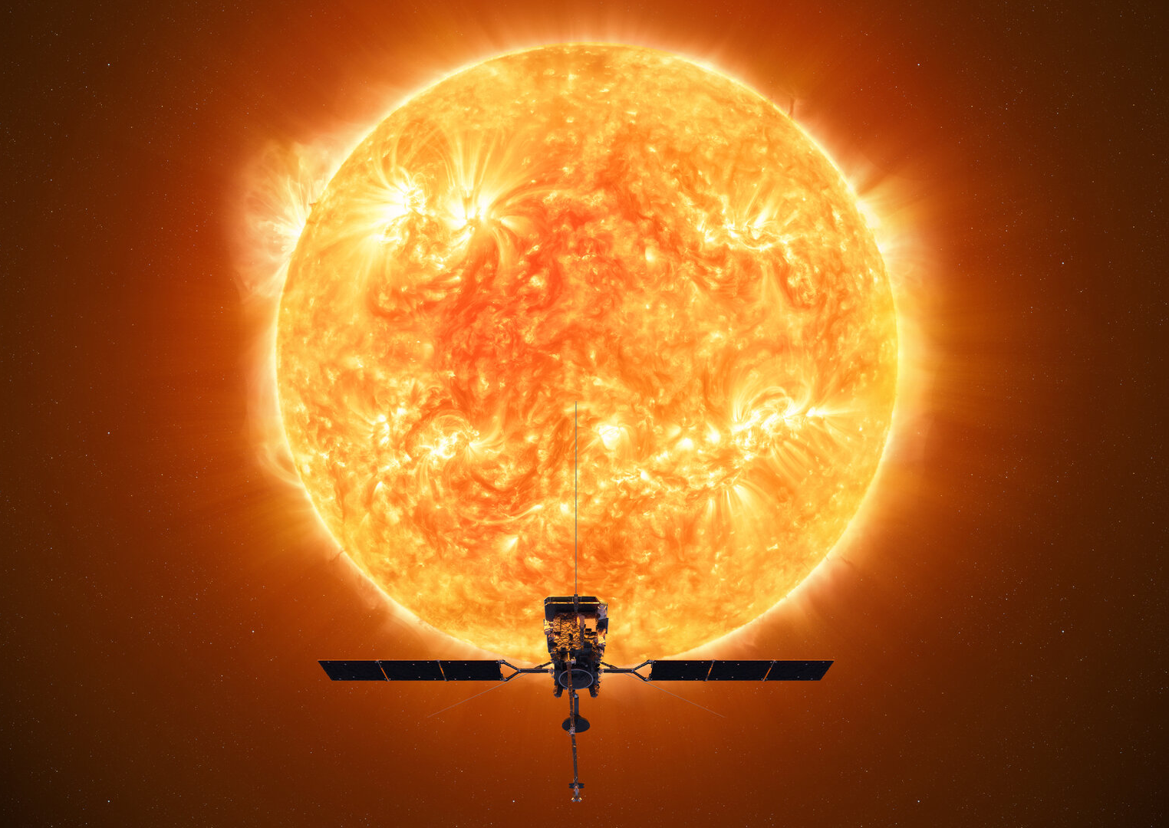
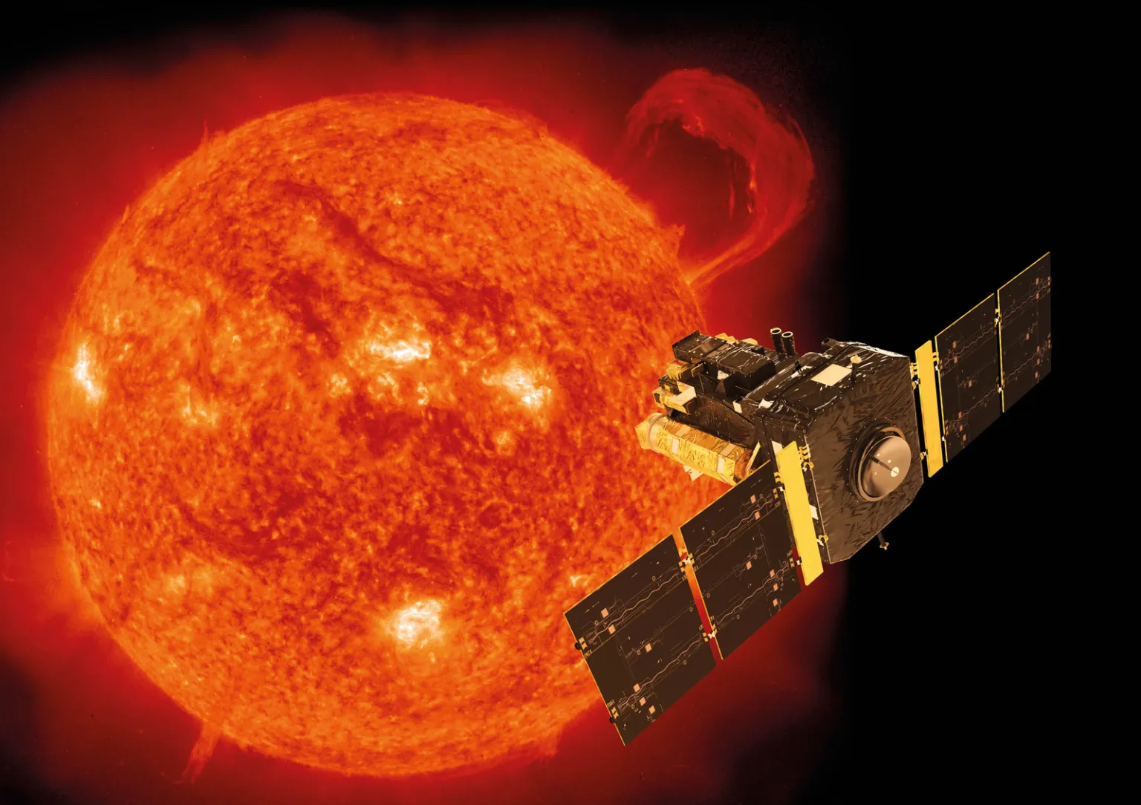
SOHO is the longest-lived Sun-watching satellite to date
Launched in December 1995, the joint NASA-ESA Solar & Heliospheric Observatory mission (SOHO), was designed to study the Sun inside out. Though its mission was scheduled to run until only 1998, it has continued collecting data, adding to scientists' understanding of our closest star, and making many new discoveries, including more than 3,000 new comets.
SOHO is a cooperative international project between ESA and NASA. NASA contributed three instruments and launch services. ESA leads the mission.
During its pioneering career, SOHO has returned a wealth of new information about the Sun—from its core to its outer atmosphere and the solar wind.
SOHO monitors the effects of space weather on our planet, and it plays a vital role in forecasting potentially dangerous solar storms.
SOHO is the most prolific discoverer of comets in astronomical history, with more than 5,000 tracked during encounters with the Sun.
ESA’s current and most advanced Sun observation satellite is the Solar Orbiter mission, with satellite launched in February 2020. It is the most complex scientific laboratory ever to have been sent to our life-giving star, taking images of the Sun from closer than any spacecraft before and being the first to look at its polar regions.
An artist's concept of the ESA-NASA SOHO spacecraft.
NASA
Source: SOHO - NASA Science

Slide 8
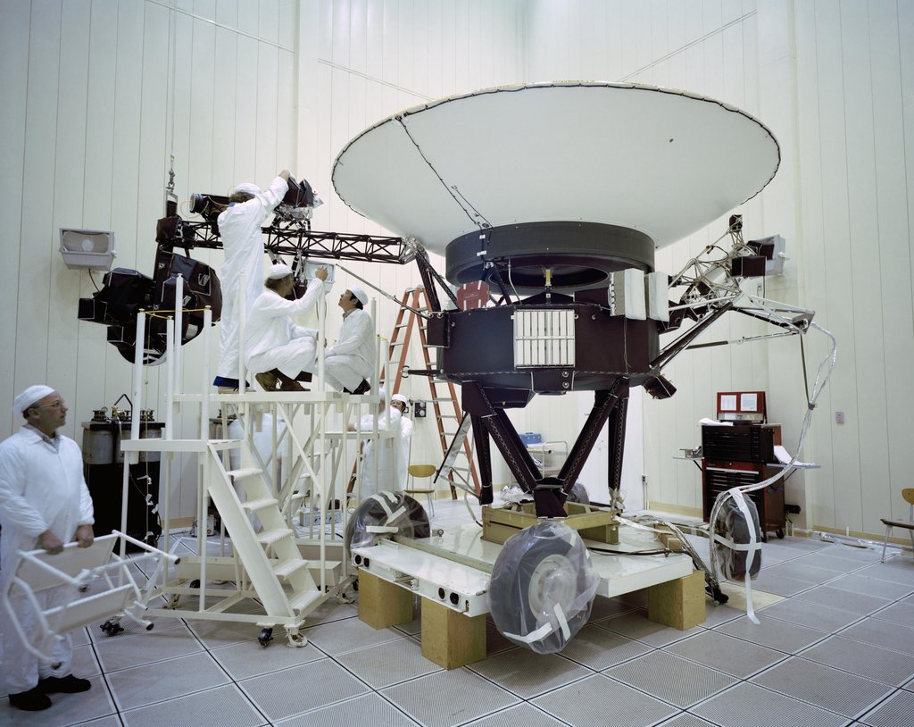
Voyager, NASA’s longest-lived mission, logs 48 years in Space
Launched in 1977, the twin Voyager probes are NASA’s longest-operating mission and the only spacecraft ever to explore interstellar space.
NASA’s twin Voyager probes have become, in some ways, time capsules of their era: They each carry an eight-track tape player for recording data, they have about 3 million times less memory than modern cell phones, and they transmit data about 38,000 times slower than a 5G internet connection.
Voyager 1 is now in interstellar space, the region outside the heliopause, or the bubble of energetic particles and magnetic fields from the Sun. Voyager 1 was launched after Voyager 2, but because of a faster route it exited the asteroid belt earlier than its twin, and it overtook Voyager 2 on Dec. 15, 1977.
Scientific instruments on Voyager 1:
Imaging Science System (ISS)
Ultraviolet Spectrometer (UVS)
Infrared Interferometer Spectrometer (IRIS)
Planetary Radio Astronomy Experiment (PRA)
Photopolarimeter (PPS)
Triaxial Fluxgate Magnetometer (MAG)
Plasma Spectrometer (PLS)
Low-Energy Charged Particles Experiment (LECP)
Plasma Waves Experiment (PWS)
Cosmic Ray Telescope (CRS)
Radio Science System (RSS)
The Voyager craft were sent into space on fly-by missions and never orbited another celestial body, and therefore are not technically satellites.
This archival image taken at NASA’s Jet Propulsion Laboratory on March 23, 1977, shows engineers preparing the Voyager 2 spacecraft ahead of its launch later that year.
Credit: NASA/JPL-Caltech
Source: Voyager, NASA’s Longest-Lived Mission, Logs 45 Years in Space

Slide 9
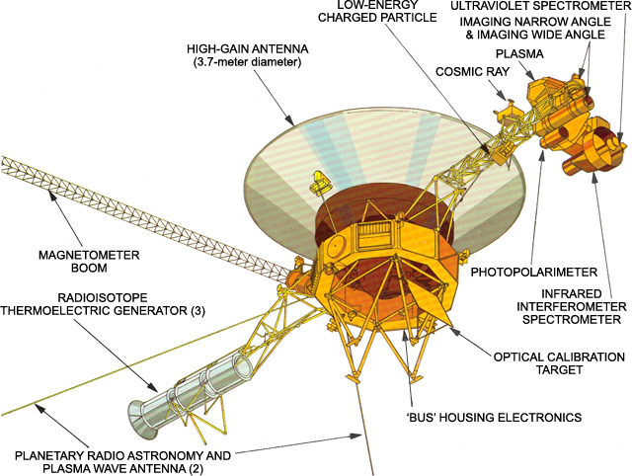
The prime mission science payload of Voyager consisted of 10 instruments (11 investigations including radio science)
Credit: NASA/JPL-Caltech. Source: Voyager - Spacecraft Instruments (nasa.gov)

Slide 10
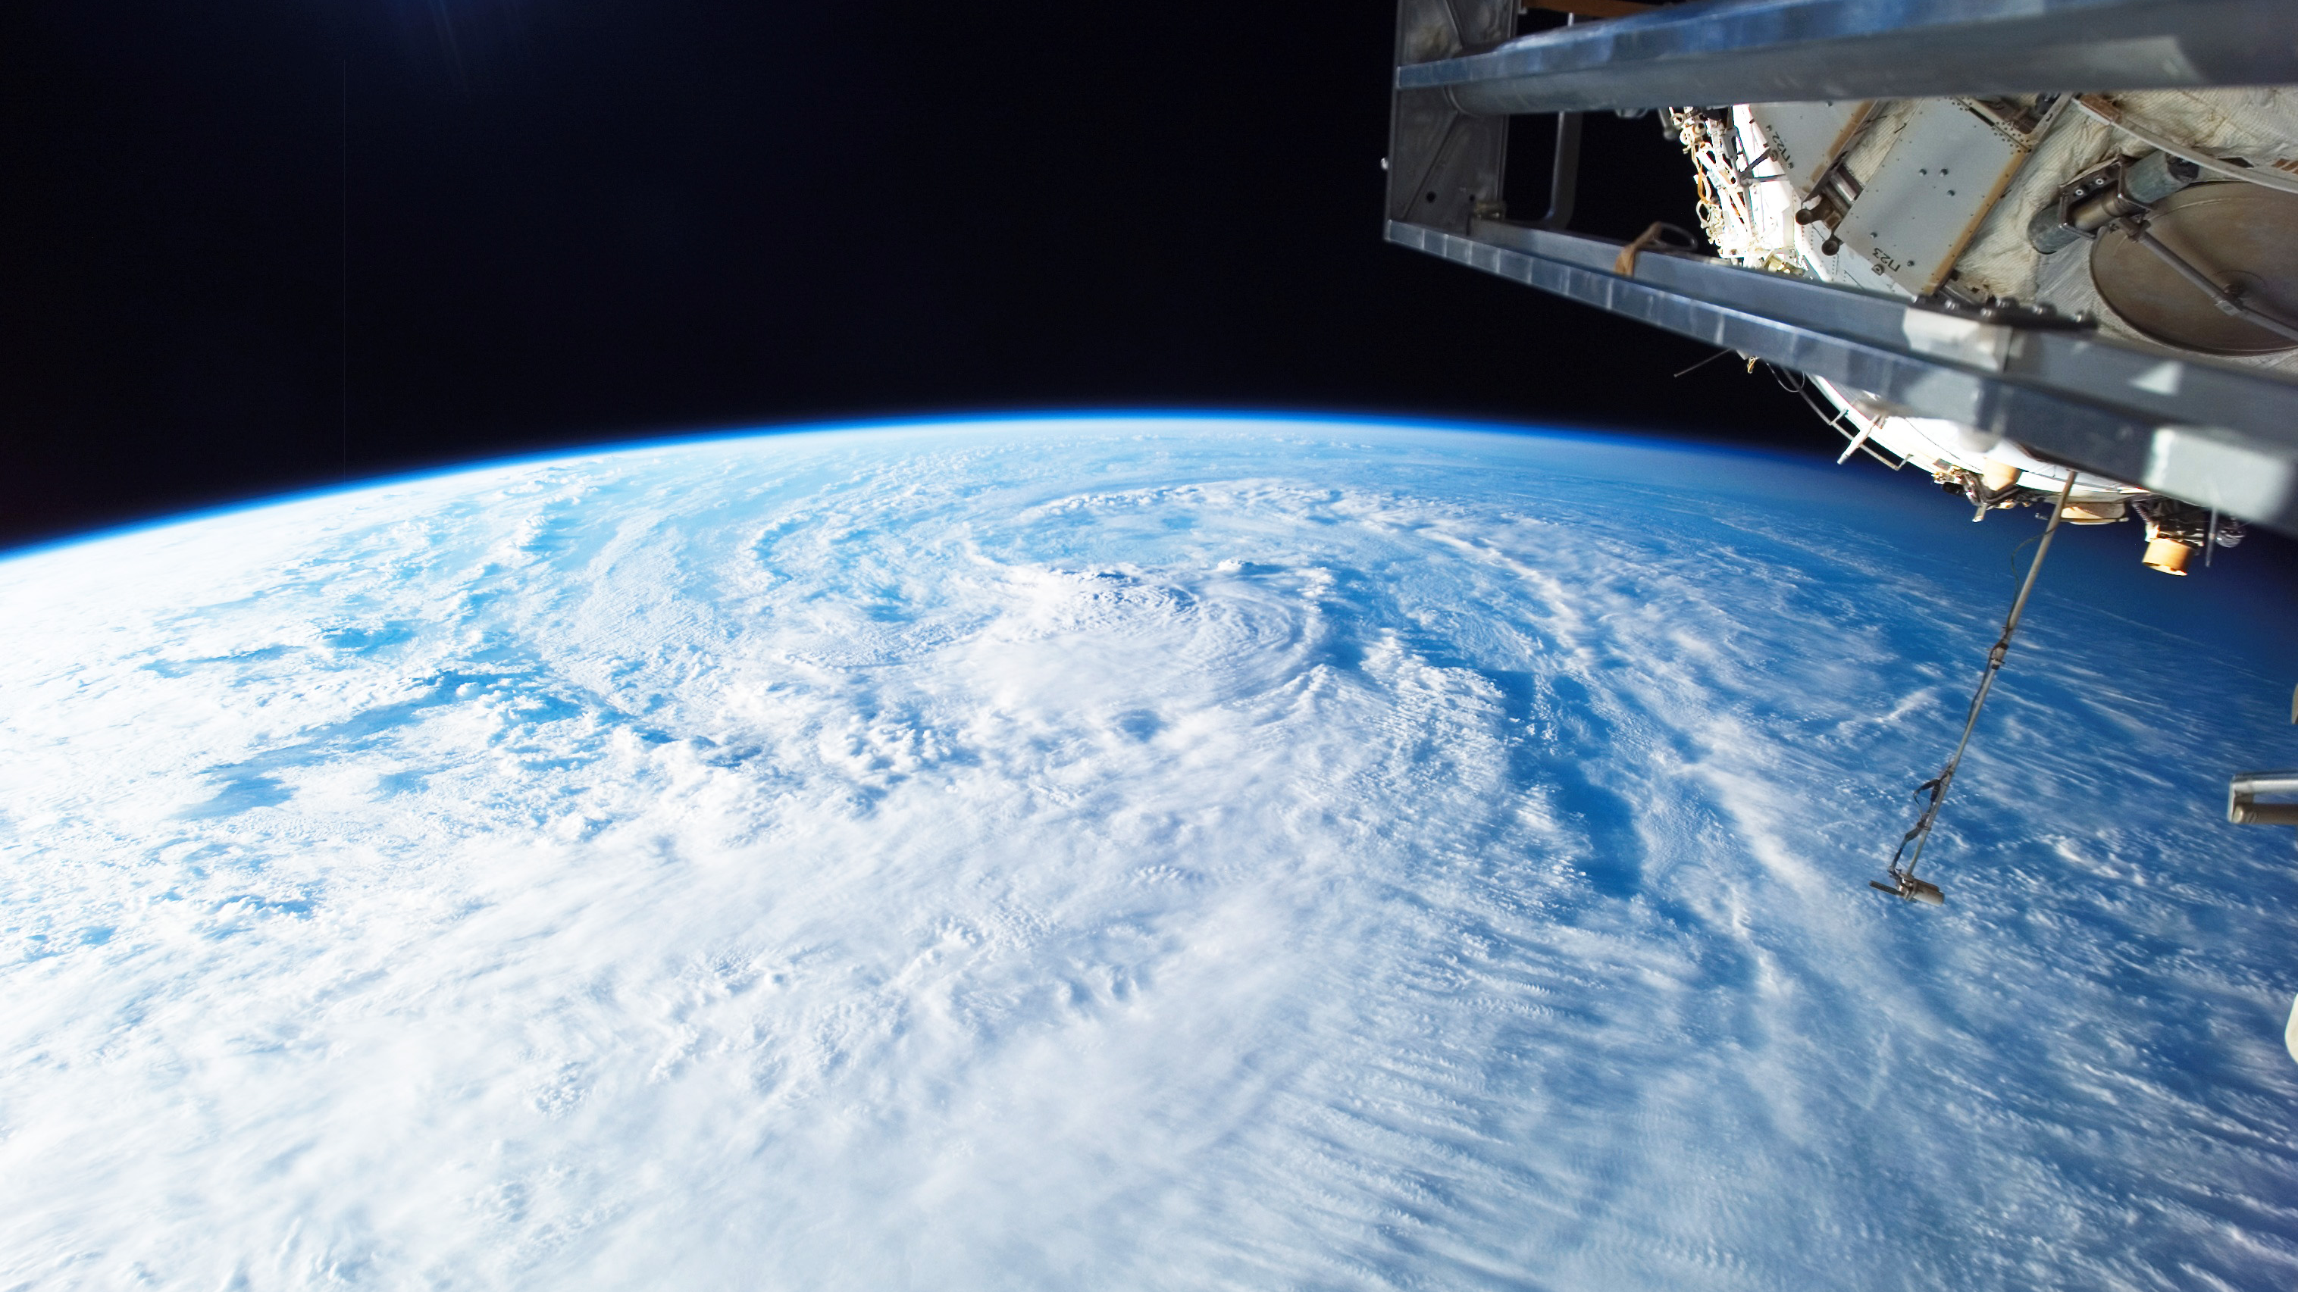
Earth observation

Slide 11
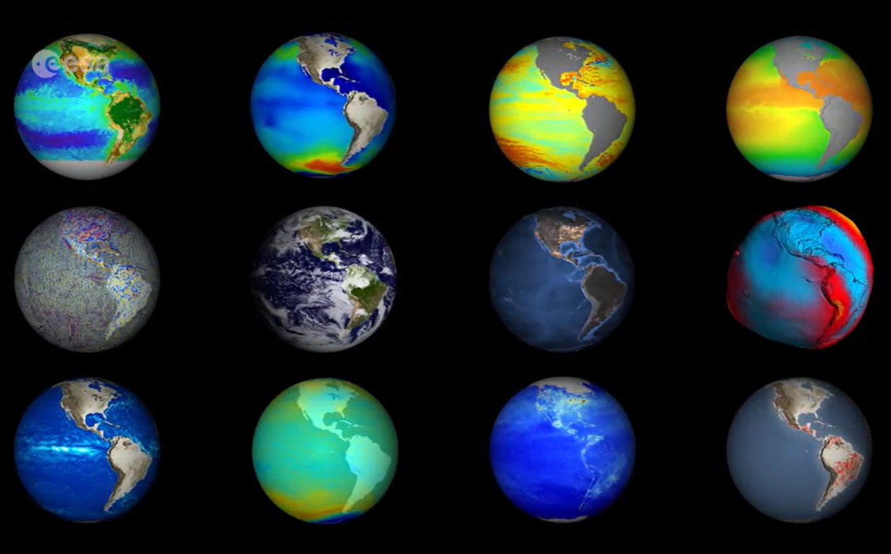
Earth Observation (EO) is the process of gathering information about the Earth’s surface, waters and atmosphere via ground-based, airborne and/or satellite remote sensing platforms
Satellites to understand our changing Earth.
Earth observation satellites provide data on oceans, ice, land environments, and the atmosphere. They are useful for monitoring and protecting our environment and planet and for helping us better understand them.
More than 1200 Earth observation satellites are currently in orbit. Their mission is to provide scientists with the essential data needed to detect environmental changes on Earth. Because more than 50% of climate variables can only be measured from Space, Earth observation satellites are a vital tool to monitor the effects of climate change on natural ecosystems.
Weather
A weather satellite is a type of satellite that is primarily used to monitor the weather and climate of the Earth.
Mapping
Terrain can be mapped from space with the use of satellites
Credit: ESA ESA - Science key to taking the pulse of our planet
Environmental monitoring
Other environmental satellites can assist environmental monitoring by detecting changes in the Earth's vegetation, atmospheric trace gas content, sea state, ocean colour, and ice fields.

Slide 12
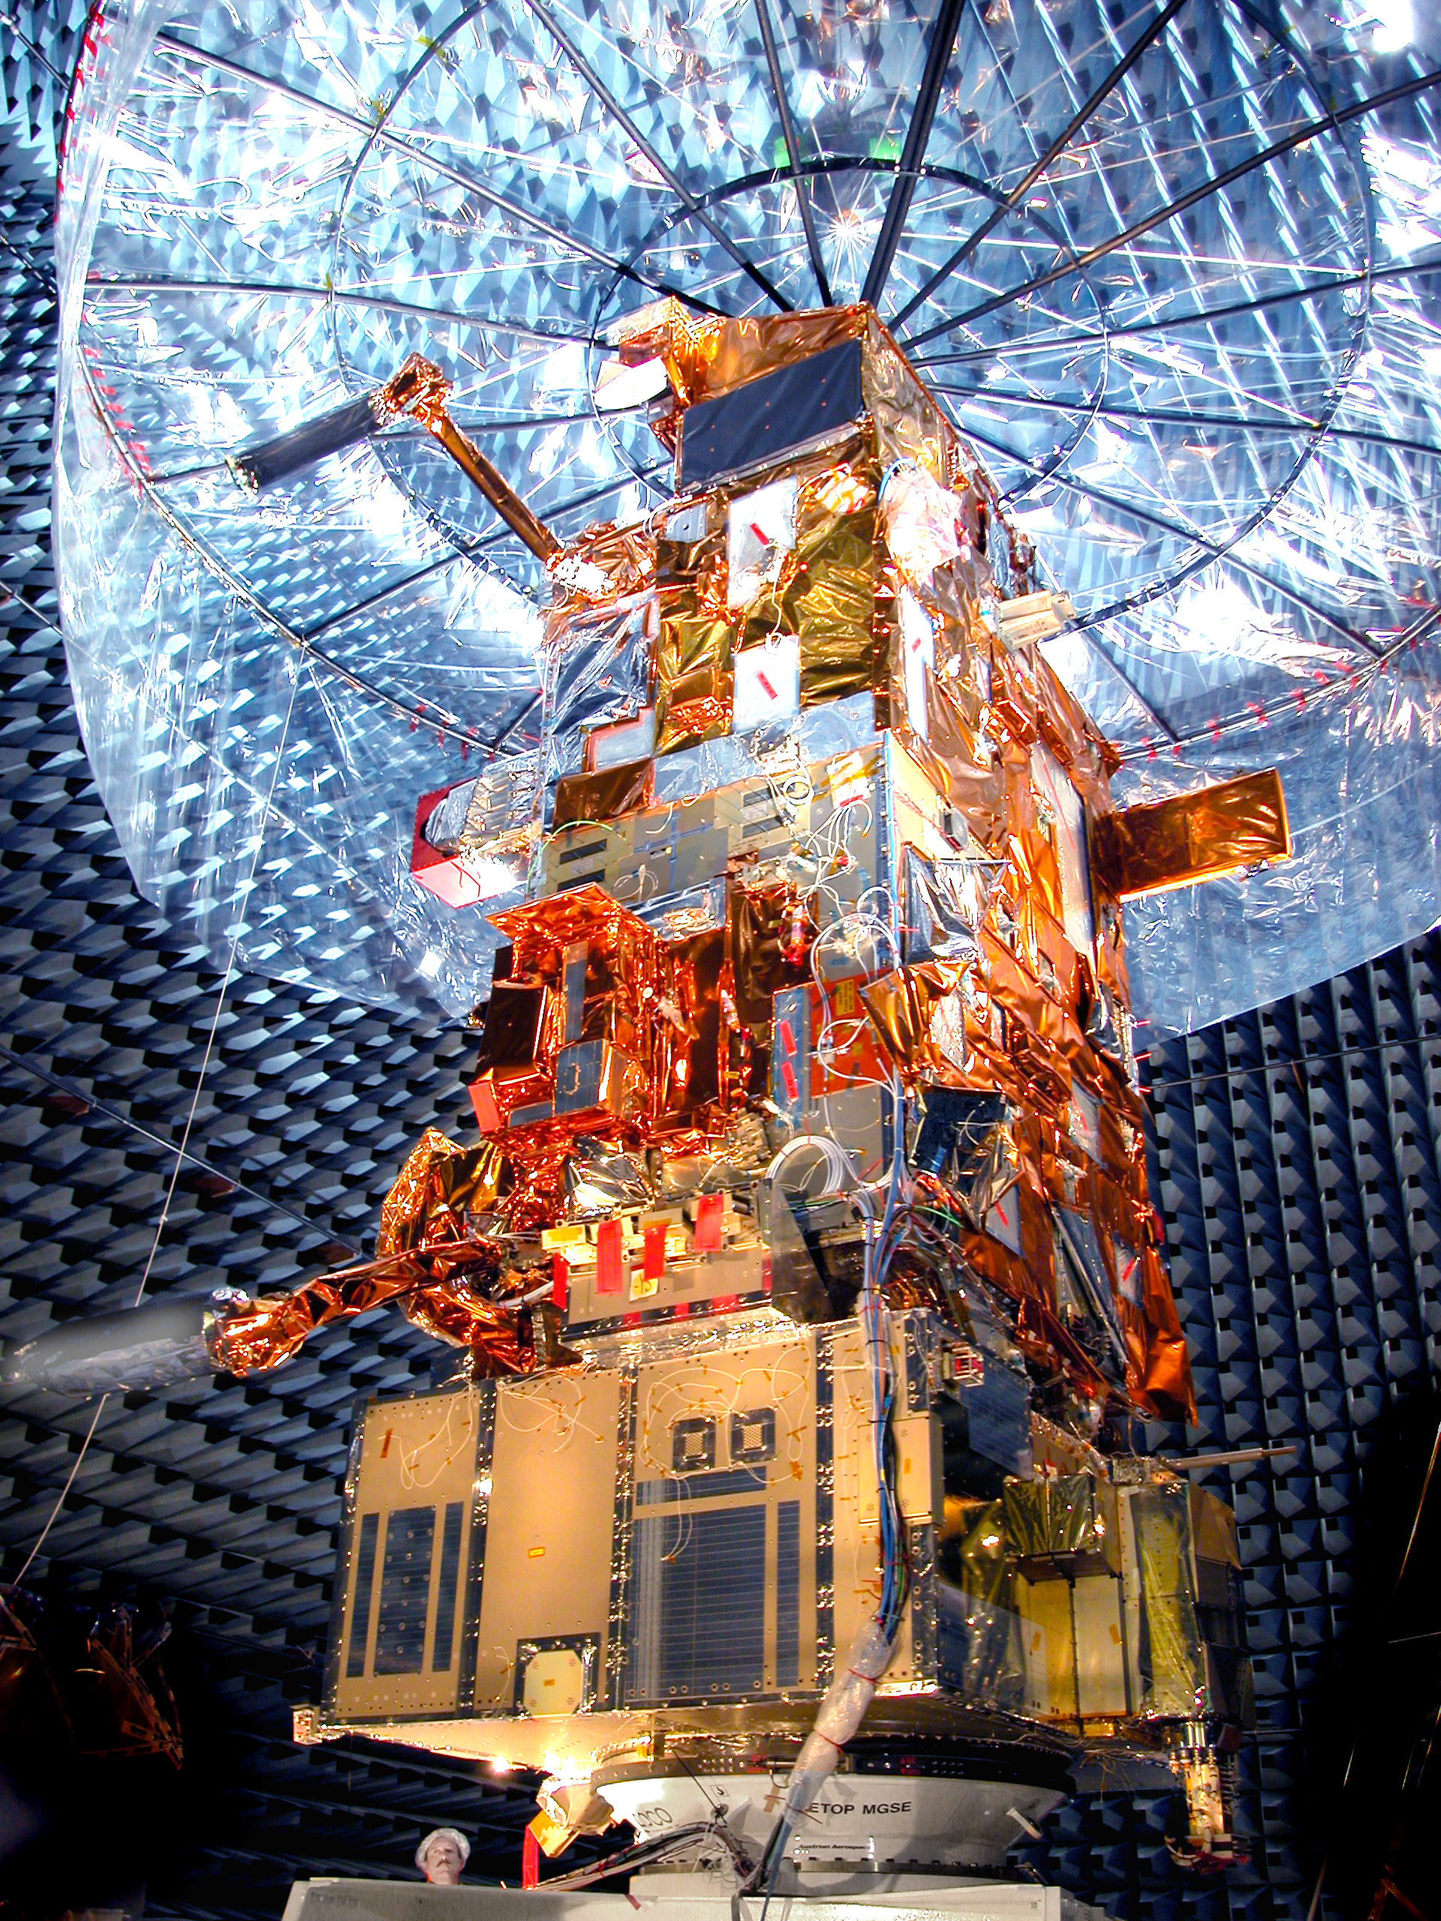
A weather satellite or meteorological satellite is a type of Earth observation satellite that is primarily used to monitor the weather and climate of the Earth
Weather and Meteorological Payloads:
Weather satellites carry instruments to monitor and collect data about the Earth's weather and climate. Payloads typically include:
radiometers,
spectrometers,
and other sensors for measuring atmospheric conditions, cloud cover, and temperature.
The two different types of weather satellites are categorized according to their orbit around Earth:
Polar-Orbiting Satellites
Polar-orbiting weather satellites orbit the Earth around the North and South Poles. They get placed in a low orbit between 200 and 1000 km above the planet.
The low orbit allows a satellite to cover every location on Earth and image the same area twice a day. The ability to cover the entire planet frequently at low orbit allows polar-orbiting satellites to get a much more detailed look at the surface and atmosphere at any given time.
The latest generation of these satellites is especially well-equipped to measure specific aspects of weather like atmospheric temperatures, various cloud parameters, as well as, humidity fields.
Geostationary Satellites
Geostationary satellites orbit the Earth at altitudes of around 35 786 kilometres, much higher than any polar-orbiting weather satellite. The vast distance from the planet's surface enables the satellites to take images of Earth's entire hemisphere at a time.
This ability helps meteorologists to get a global picture of atmospheric and surface conditions.
A geostationary satellite also orbits around the Equator at the same frequency the Earth rotates, which means the satellite always remains in one location above the planet.
MetOp-A satellite
Credit: ESA ESA - MetOp-A satellite

Slide 13
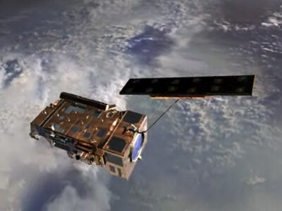
MetOp-A, Europe's first polar-orbiting satellite dedicated to operational meteorology
MetOp-A video
ESA - MetOp-A Satellite VNR June 2006
The video explains that MetOp-A represents the European contribution to cooperative venture with the United States (NOAA) to provide data that is used to monitor our climate and improve weather forecasting.
The Meteorological Operational satellite programme (MetOp) is a European undertaking providing weather data services to monitor the climate and improve weather forecasts. It represents the European contribution to co-operative venture with the United States’ National Oceanic and Atmospheric Administration (NOAA).
MetOp is a series of three satellites, forming the space segment of Eumesat's Polar System (EPS). Launched on 19 October 2006, MetOp-A, the first satellite in the series was Europe’s first polar-orbiting satellite dedicated to operational meteorology. It was decommissioned in 2021. MetOp-B, the second in the series, was launched on 17 September 2012 and is still operational as of 2025. The third and final satellite, MetOp-C was launched in 2018 and is currently operational.
The MetOp Second Generation mission, or MetOp-SG for short, will follow-on from the first series of MetOp satellites. The main reason why MetOp Second Generation has been designed to work as a pair is because the instruments needed are so large that it takes two satellites to accommodate them. First satellite in the series, MetOp-SG-A1 was launched on August 13th 2025. Its tandem B1 is scheduled for launch in 2026.
Each pair of satellites carries a total of ten instruments. The instruments are either significantly improved versions of those on the first generation or completely new, to provide measurements of unprecedented accuracy – not only for numerical weather prediction, but also for nowcasting at high latitudes, climate monitoring, atmospheric chemistry, oceanology, hydrology, and land applications.
Solar array deployment
Credit: ESA ESA - Europe’s new MetOp weather satellite reaches polar orbit

Slide 14
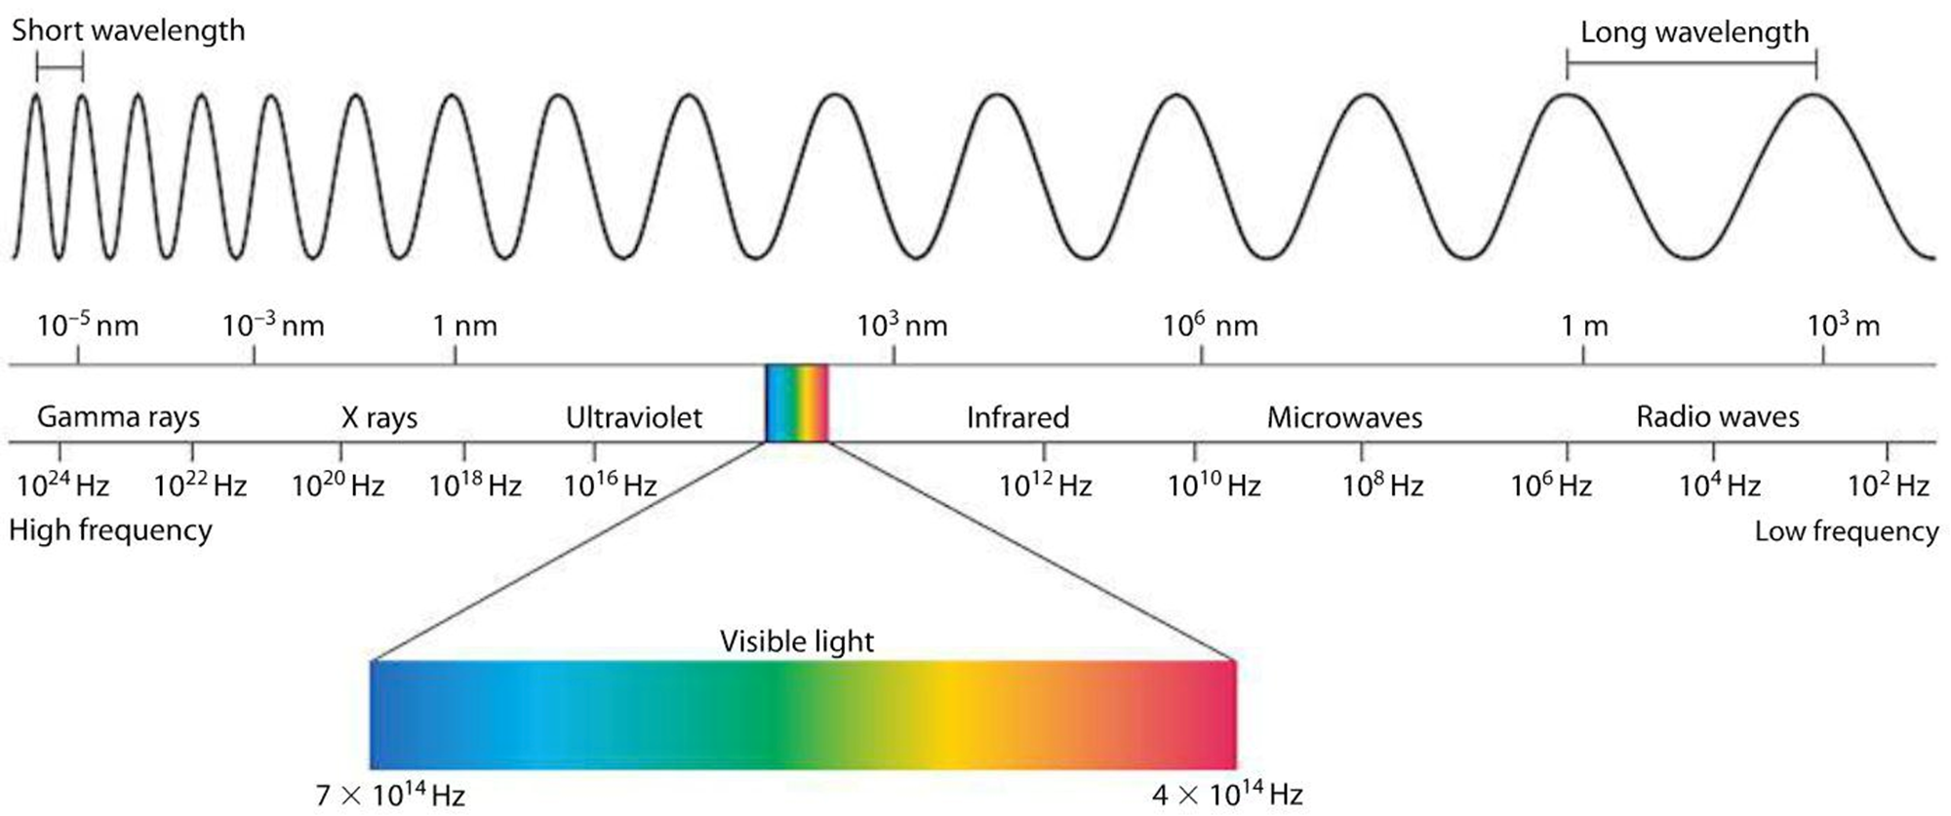
Satellites extract information from energy interacting with the Earth’s surface
Remote sensing sensors measure the electromagnetic radiation from reflection, emission, and emission reflection.
Light acts as a wave that can be described by its wavelength and frequency, comprising the electromagnetic spectrum.
Longer wavelengths contain less energy and shorter wavelengths contain more.
The electromagnetic spectrum
Sources: Introduction to Satellite Imagery – Polar Geospatial Center (umn.edu)
https://up42.com/blog/introduction-optical-satellite-imagery

Slide 15
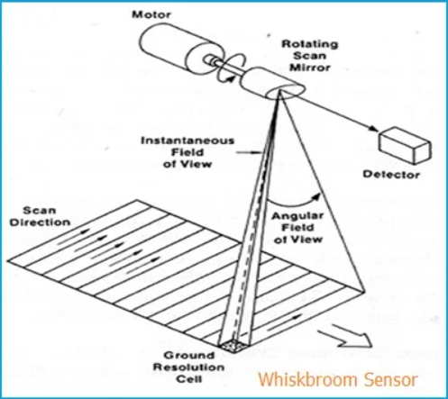
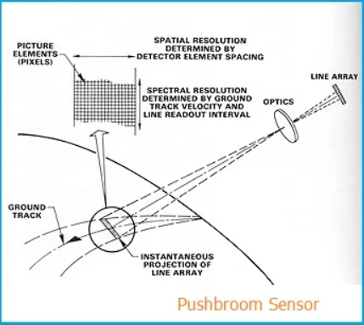
Sensors are equipped with different imaging systems: whiskbroom (cross-track) scanners and “pushbroom” (along-track) scanners
Satellites in orbit observe the same point on earth in regular intervals, known as revisit times. These times vary depending on orbit, altitude, location, swath, etc. and are crucial for time-series analysis and detecting change.
Whiskbroom scanners move in the direction of the orbital track while scanning across-track with a mirror. This results in a wide swath width and resolution varying with scan angle and can cause pixel distortion. Common whiskbroom scanners include Landsat MSS/TM/ETM+ and AVHRR.
Pushbroom scanners move in the direction of the orbital track while scanning along-track without any mirror. This results in a narrower swath width and no pixel distortion. “Pushbroom” scanners are preferred for high spatial resolution sensors and include Landsat 8, QuickBird, and IKONOS.
Source: Difference between Whiskbroom Sensor vs Pushbroom Sensor (rfwireless-world.com)
See video: NASA SVS | Landsat sensors: pushbroom vs whiskbroom

Slide 16
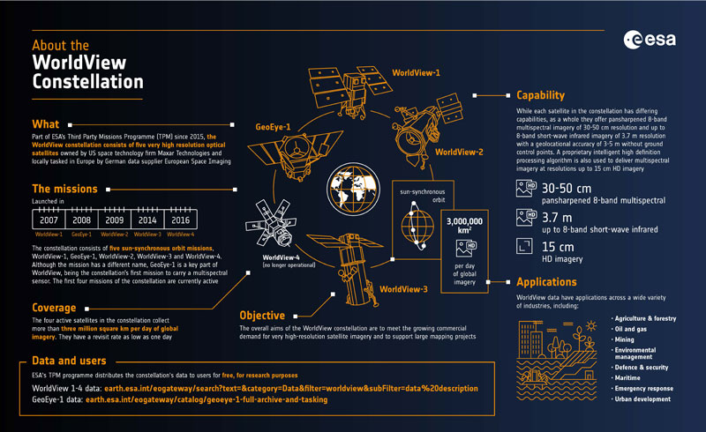
The WorldView Series consists of high-resolution commercial Earth imaging satellites
Owned by Maxar, WorldView series of satellites have been supplying imagery since 2007.
WorldView-1 launched in 2007, it was the world's first 50 cm resolution commercial imaging satellite
WorldView-2 launched in 2009, increased resolution to 46cm.
WorldView-3 launched in 2014, further increased resolution to 31cm, roughly the same as WorldView-4 .
WorldView Legion constellation further improved resolution to ~30cm, and significantly improved revisit rates (up to 15 per day per location). First satellite was launched on May 2nd 2024. Currently 6 are in operation, with last launch up to date on February 4th 2025. Constellation is planned to expand to 12 satellites.
Credit: ESA
Source: WorldView Series - Earth Online (esa.int)

Slide 17
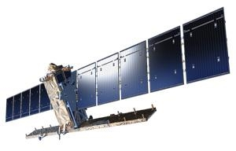
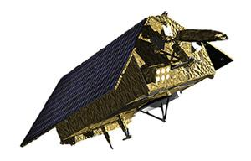
Copernicus is the European Union's flagship Earth observation initiative, designed to provide valuable information services to citizens and organizations across the EU
Copernicus Satellites:
Sentinel-1 provides all-weather, day and night radar imagery for land and ocean services.
Sentinel-2 provides high-resolution optical imagery for land services. It provides for example, imagery of vegetation, soil and water cover, inland waterways and coastal areas. Sentinel-2 also delivers information for emergency services.
Sentinel-3 provides high-accuracy optical, radar and altimetry data for marine and land services. It measures variables such as sea-surface topography, sea- and land-surface temperature, ocean colour and land colour with high-end accuracy and reliability.
Sentinel-4 launched on July 1st 2025. It will provide data for atmospheric composition monitoring. Its objective is to monitor key air quality trace gases and aerosols over Europe at high spatial resolution with a fast (hourly) revisit time.
Sentinel-5, launched on August 13th 2025 will also be dedicated to atmospheric composition monitoring.
Sentinel-6 provides high accuracy altimetry for measuring global sea-surface height, primarily for operational oceanography and for climate studies.
Sentinel-6B which offers continuity for Sentinel-6 is scheduled for launch on November 17th
The European Commission manages the Copernicus Programme. It is implemented in partnership with the Member States, the European Space Agency (ESA), the European Organisation for the Exploitation of Meteorological Satellites (EUMETSAT), the European Centre for Medium-Range Weather Forecasts (ECMWF), EU Agencies and Mercator Océan, the European Environment Agency (EEA), the Joint Research Centre (JRC).
Copernicus supports a variety of applications in several non-space domains, which potentially impact businesses and organizations in day-to-day activities and operations.
Agriculture
Blue Economy
Climate Change and Environment
Development and Cooperation
Energy and Natural Resources
Forestry
Health
Insurance and Disaster Management
Security and Defence
Tourism
Transport
Urban Planning
Copernicus Sentinel-1
Source: Discover our satellites | Copernicus
Copernicus Sentinel-6
Source: Discover our satellites | Copernicus

Slide 18
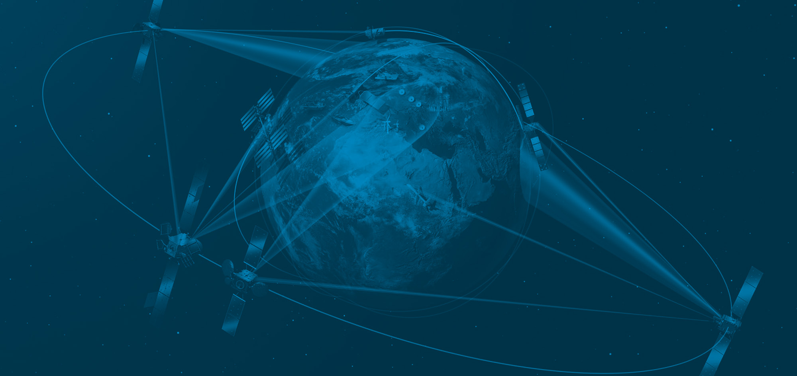
Military surveillance
Image credit: ESA

Slide 19
Military satellites are an essential component of modern warfare, providing crucial intelligence, communication, and surveillance capabilities to military forces
These are just a few examples of the types of military satellites and their functions. The specific capabilities and technologies of military satellites can vary widely depending on their purpose and the needs of the military forces using them.
There are several types of military satellites, each with its specific functions. Here are some of the most common types:
Reconnaissance satellites:
These satellites are used for intelligence gathering and surveillance purposes. They can capture high-resolution images of the Earth's surface, providing military forces with information on potential targets, enemy movements, and other critical data.
Weather satellites:
These satellites monitor weather patterns and conditions worldwide. They can provide information on storms, precipitation, and other weather events, allowing military forces to plan their operations accordingly.
Communication satellites:
Communication satellites provide secure and reliable links between military forces and their headquarters. They can transmit voice, data, and video signals over long distances, allowing military forces to communicate effectively in real time.
Electronic Intelligence (ELINT) satellites:
These satellites detect and analyse electronic signals, including radar emissions and other types of electromagnetic radiation. They provide valuable intelligence on the location and capabilities of enemy forces and equipment.
Missile warning satellites:
These satellites detect and track ballistic missile launches. They provide early warning of missile attacks, allowing military forces to take defensive measures.
Navigation satellites:
These satellites provide positioning and navigation data to military forces on the ground and in the air. They allow military forces to navigate precisely and accurately, even in remote or hostile environments.
Anti-satellite weapons:
These are not technically satellites themselves but are weapons designed to destroy or disable enemy satellites. They can be used to disrupt enemy communications or to prevent them from gathering intelligence.

Slide 20
Electronic intelligence (ELINT) is intelligence gathered using electronic sensors
First ELINT satellites
The history of Electronic Intelligence (ELINT) satellites dates back to the early days of the Cold War.
The need for gathering intelligence about the adversary’s electronic emissions became increasingly crucial. The concept of using satellites to intercept and analyse these signals was born out of this necessity.
The United States was the first nation to develop and launch ELINT satellites. In 1960, the U.S. Navy launched the first operational ELINT satellite, known as GRAB (Galactic Radiation and Background). GRAB was designed to detect and record Soviet radar signals, providing valuable insights into the USSR’s air defence capabilities.
The first Soviet ELINT satellites, known as Tselina-O, was launched in 1967. These smaller satellites were designed to make low-sensitivity measurements of electronic signals. In parallel, the Soviets developed the more complex Tselina-D satellites, which were capable of precise measurements and location determination of targets of interest.
ELINT is mainly of three types:
TechELINT
TechELINT refers to the technical aspects of electronic intelligence, including a signal's structure, operational modes and emission characteristics. The emitter functions associated with certain systems, such as radars, beacons and jammers, are also considered TechELINT.
OpELINT
Operational ELINT or OpELINT focuses on gathering the operational patterns of specific ELINT target systems.
TELINT
TELINT, alsospelled as TelELINT and more commonly known as Foreign Instrumentation Signals Intelligence or FISINT, is telemetry signals intelligence that provides insights into a foreign country's missiles, space vehicles and remote-controlled systems. Intercepting, processing and analysing TELINT enables countries to capture performance and operational information about these systems, aiding in the development of measures to counter the potential threat posed by those systems.
ELINT also helps nations implement countermeasures to withstand electronic threats like jamming and cyberattacks. In the long term, ELINT is invaluable to understand an adversary nation's electronic capabilities and accordingly determine what measures are required to either withstand or overtake them.

Slide 21
ELINT relies on a range of techniques and tools to gather and analyze electronic signals
Some of the commonly used techniques include:
Signal Intercept:
Intercepting electronic signals through various means, such as antennas, satellites, or specialized equipment.
Signal Analysis:
Analysing intercepted signals to extract valuable information, such as the type of communication system, Encryption techniques used, or potential vulnerabilities.
Traffic Analysis:
Analysing patterns and characteristics of network traffic to identify anomalies or suspicious activities. This includes analysing protocols, packet headers, and payload content.
Pattern Recognition:
Applying machine learning and data Analytics techniques to identify patterns in electronic signals and detect potential threats or vulnerabilities.

Slide 22
Even though Russia was the first country to put a satellite into space, the United States has the most military satellites in space today
Country | # Military Satellites
United States | 247
China | 157
Russia | 110
France | 17
Israel | 12
Italy | 10
India | 9
Germany | 8
United Kingdom | 6
Spain | 4
Top 10 countries. In total 31 county has military satellite.
Source: Military Satellites by Country 2025 (worldpopulationreview.com)

Slide 23
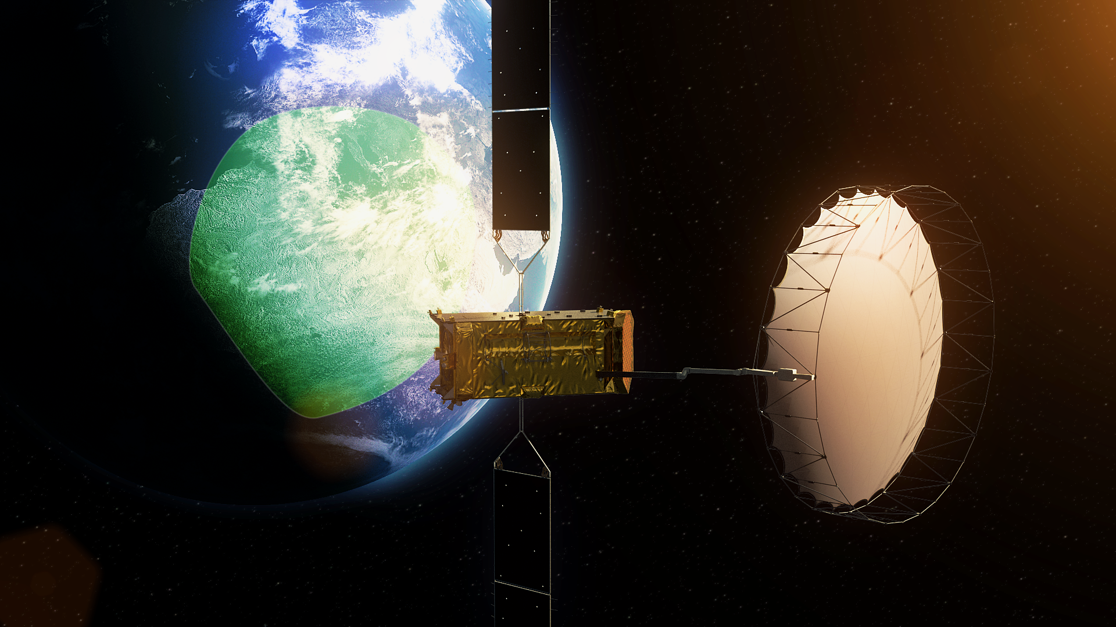
Communication
Image credit: ESA

Slide 24
Satellite communications enables voice and data communication services across the globe
Satellites have fundamentally transformed global connectivity by extending communication infrastructure to remote and underserved regions, bridging the digital divide and enabling access to critical services.
Satellites enable global communication in remote areas efficiently.
Advanced satellite systems optimize data transmission for reliable connectivity.
Satellite technology bridges digital gaps, enhancing global connectivity.
Satellite networks ensure seamless, high-quality broadcasting for diverse audiences.
There are three types of communication services that satellites provide
Telecommunications
Telecommunication services include telephone calls and services provided to telephone companies, as well as wireless, mobile, and cellular network providers.
Broadcasting
Broadcasting services include radio and television delivered directly to the consumer and mobile broadcasting services
Data
Data communications involve the transfer of data from one point to another.

Slide 25
A very small aperture terminal (VSAT) is a two-way ground station with a dish antenna that is smaller than 3.8 meters that transmits and receives data from satellites
A VSAT is capable of both narrow and broadband data to satellites in orbit in real-time. The data can then be redirected to other remote terminals or hubs around the planet.
VSATs are used to:
transmit narrowband data (e.g., point-of-sale transactions using credit cards, polling or RFID data, or SCADA),
broadband data (for the provision of satellite Internet access to remote locations, VoIP or video)
transportable, on-the-move (utilizing phased array antennas) or mobile maritime communications.
VSATs typically operate in C, Ku, and Ka-bands, with C-band being more robust, Ku-band most widely deployed commercially, and Ka-band offering high-throughput broadband. Military/government VSATs may use X- or S-band.
VSAT’s critical components:
VSAT Terminal: This is the user equipment installed at your location. It includes a dish antenna, transceiver unit, and modem for sending and receiving signals.
Satellite: The VSAT system relies on satellites in geosynchronous or geostationary orbit. These satellites appear stationary from the Earth’s perspective, enabling a constant connection.
Network Operations Centre (NOC): This central hub manages the VSAT network, ensuring smooth communication between terminals and satellites.

Slide 26
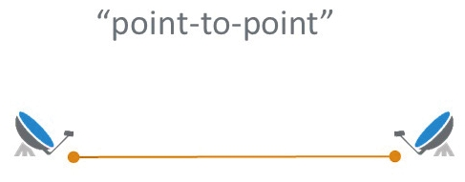
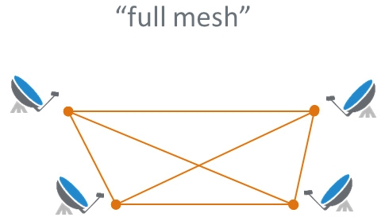
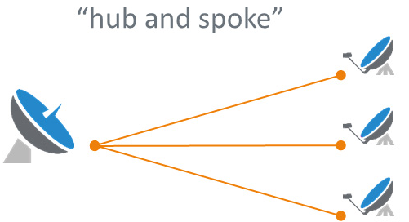
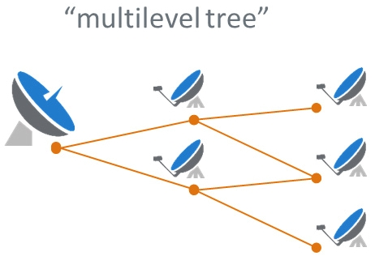
The networks based on VSAT technology are of two main areas: the dedicated services and the shared ones
The shared services (TDMA) allow several remote stations to share the same network in time division. The dedicated services communicate within each other without the need of a hub and on single carrier per channel.
Point-to-Point links (SCPC)
SCPC (Single Channel Per Carrier) is a satellite network topology which allows the connection of a specific single point to another specific single point without going through any other earth station. This technology is used when bulk data transfer is required, for example for data, voice and/or video transfer.
Point to Multi-Point (Mesh)
TDMA (Time Division Multiple Access) is a satellite network topology that allows several remote terminals to inter-communicate in a single hop and without having to pass via the central hub, reducing in half, the delay when compared to TDMA Star topology.
Star Networks (TDMA)
TDMA (Time Division Multiple Access) is a satellite network topology that allows the implementation of a STAR network where all the remote stations are dynamically connected (in time division) via satellite to a central hub. Two (or several) remotes can still communicate with each other, but it would be via the central hub with double the round-trip delay.
Multi-Point with Multi-Point and Star
This Network topology allows all the remotes to access internet/Intranet via the main Hub (in Star topology mode) and to communicate within (or with?) each other in single hop (In mesh topology mode) without having to pass by the main Hub (and therefore with the delay of a single hop), depending on the different IP classes pre-assigned to the single sub-networks.

Slide 27
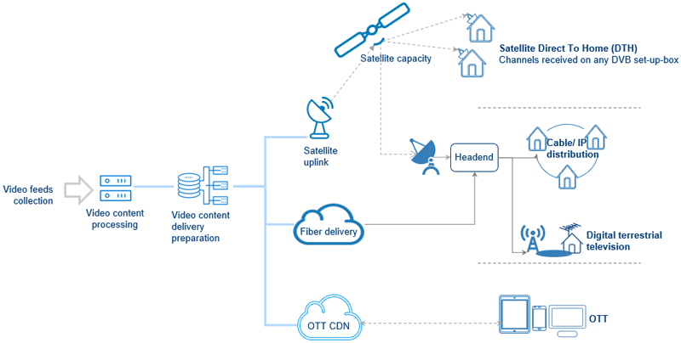
Satellite Direct-to-Home achieves video delivery via radio waves received through a satellite dish
TV distribution itself can come in many different shapes and sizes, but there are three main types of delivery models:
Terrestrial networks (e.g. Cable, IP and DTT distribution)
Satellite Direct-to-Home
OTT (Over-the-Top)
Satellite Direct-to-Home enables broadcasters to directly beam their channels to the viewer’s TV set. This means that viewers have no need for a separate cable connection to access the TV channels.
The biggest advantage of satellite television for broadcasters is its unique reach.
Cost is another important element for broadcasters. While some infrastructure transmission costs increase based on the number of users, with satellite transmission, costs remain the same no matter how many viewers you reach.
Another concern that potentially faces broadcasters is the maturity of DTH technology, yet DTH viewing is growing in every region and it can distribute any format, including 4k.
Among the advantages for DTH viewers are the superior quality of content, since the signal is not split through a cable, and there is no cable operator who curates and curbs channel choice.
The disadvantages for viewers largely depend on the region and prevailing business models. In some regions, viewers can access thousands of free TV channels with just a low-cost satellite dish and set-top box, and no monthly fees, while elsewhere, setting up the receiving apparatus can be more costly and require time and effort.
Main types of TV distribution models.
Source: A Guide to TV Distribution Models (DTH vs Terrestrial vs OTT) | Eutelsat

Slide 28
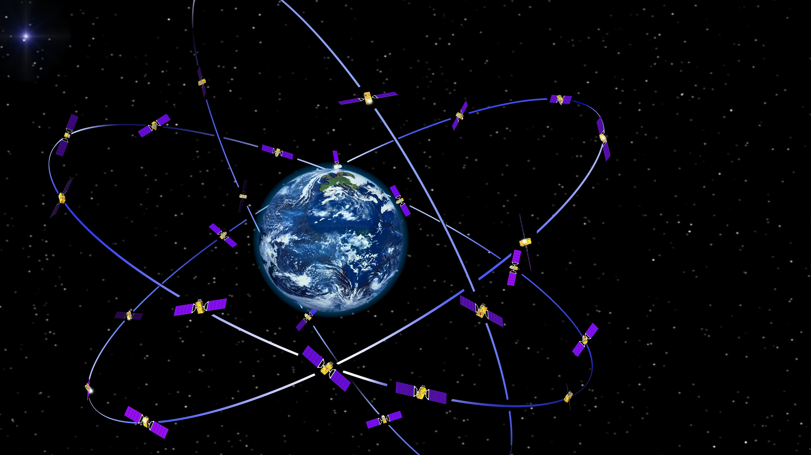
Navigation
Image credit: ESA

Slide 29
Global Navigation Satellite System (GNSS) refers to any satellite constellation that provides global positioning, navigation, and timing services
Several GNSS are currently available.
GPS (USA) /
Global coverage
GPS is operated by the U.S. Space Force, a branch of the U.S. Armed Forces. It was the first constellation to be established in space with its first satellite being launched in 1978, with its first series of satellites fully operational by 1993.
GLONASS (Russia) / Global coverage
GLONASS was first developed in the Soviet Union to compete with GPS during the ‘70s and is currently operated by Roscosmos State Corporation for Space Activities, a department in the Russian government. The first GLONASS satellite was launched in 1982 and today has 24 satellites in orbit.
The constellation was fully launched and completed in 1995, with full satellite coverage achieved across Russia in 2010.
Galileo (EU) /
Global coverage
Galileo is a more recent constellation first launched in 2011. Operated out of the European Union by the European Global Navigation Satellite Systems Agency, Galileo currently has 26 active satellites in orbit.
BeiDou (China) / Global coverage
First launched in 2000, BeiDou operates out of China by the China National Space Administration (CNSA). It has more than 50 satellites in orbit.
QZSS (Japan)
Japan’s Quasi-Zenith Satellite System (QZSS) is operated by the Japan Aerospace Exploration Agency (JAXA) and was first launched in 2010. While the other constellations have provided global coverage, QZSS maintains Asia-Oceana regional coverage between Japan and Australia.
As a regional constellation, QZSS only has five satellites currently in orbit, with a plan for an additional two satellites for full coverage.
IRNSS/NavIC (India)
Indian Regional Navigation Satellite System (IRNSS) operated by the Indian Space Research Organization (ISRO) out of India. IRNSS is also known as NavIC (Navigation with Indian Constellation) and includes eight satellites in orbit.
The constellation’s coverage centres around India, reaching west to include Saudi Arabia, north and east to include all of China and as far south to include both Mozambique and Western Australia.

Slide 30
Comparing GNSS constellations
GNSS | Operator | Coverage | Altitude (km) | Satellites in Orbit
GPS | US Space Force | Global | 20180 | 32
GLONASS | Roscosmos | Global | 19130 | 24
Galileo | GSA and ESA | Global | 23222 | 27
BeiDou | CNSA | Global | 21528 (MEO satellites) 35786 (GEO and IGSO Satellites) | 48
QZSS | JAXA | Regional | 32000 (perigee) 40000 (apogee) | 5
IRNSS/NavIC | ISRO | Regional | 36000 | 7

Slide 31
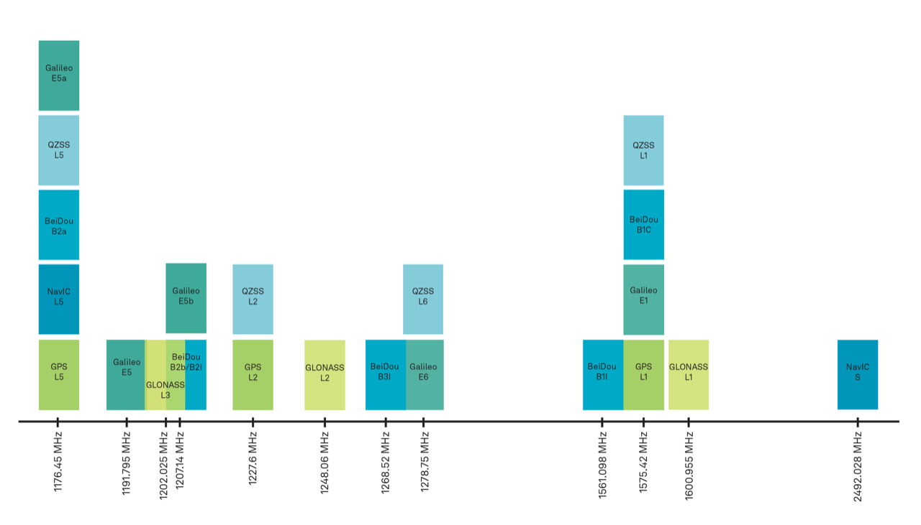
Comparing GNSS frequencies

Slide 32
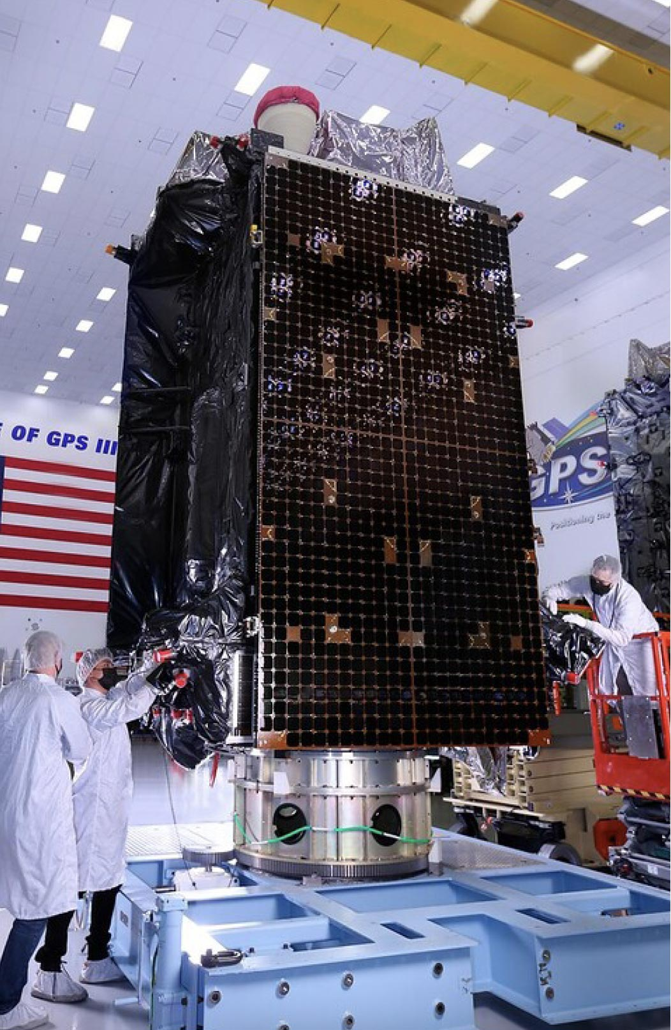
The Global Positioning System (GPS) is a U.S.-owned utility that provides users with positioning, navigation, and timing (PNT) services
History:
The GPS project was started by the U.S. Department of Defense in 1973. The first prototype spacecraft was launched in 1978 and the full constellation of 24 satellites became operational in 1993.
Civilian use by the United States military was limited to an average of 100-meter uncertainty in location by broadcasting Selective Availability (SA). On May 1, 2000, SA was removed to provide free civil access to the full GPS accuracy
When Selective Availability was discontinued, GPS was accurate to about 5 meters (16 ft). GPS receivers that use the L5 band have much higher accuracy of 30 centimetres (12 in), while those for high-end applications such as engineering and land surveying are accurate to within 2 cm (3⁄4 in) and can even provide sub-millimeter accuracy with long-term measurements
Consumer devices such as smartphones can be accurate to 4.9 m (16 ft) or better when used with assistive services like Wi-Fi positioning.
The United States is committed to maintaining the availability of at least 24 operational GPS satellites, 95% of the time. To ensure this commitment, the U.S. Space Force has been flying 31 operational GPS satellites for well over a decade.
GPS satellites fly in medium Earth orbit (MEO) at an altitude of approximately 20,200 km (12,550 miles). Each satellite circles the Earth twice a day.
The satellites in the GPS constellation are arranged into six equally-spaced orbital planes surrounding the Earth. Each plane contains four "slots" occupied by baseline satellites. This 24-slot arrangement ensures users can view at least four satellites from virtually any point on the planet.
The Space Force normally flies more than 24 GPS satellites to maintain coverage whenever the baseline satellites are serviced or decommissioned. The extra satellites may increase GPS performance but are not considered part of the core constellation.
Block III GPS satellite (Lockheed Martin)
Source: Step 1 — Satellites | NovAtel

Slide 33
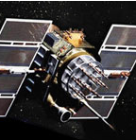
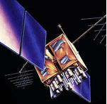
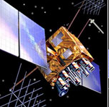
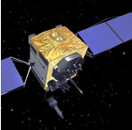
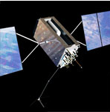
The GPS space segment consists of 31 satellites
Legacy satellites
Modernized satellites
BLOCK IIA
0
operational
Coarse Acquisition (C/A) code on L1 frequency for civil users
Precise P(Y) code on L1 & L2 frequencies for military users
7.5-year design lifespan
Launched in 1990-1997
Last one decommissioned in 2019
BLOCK IIR
6
operational
C/A code on L1
P(Y) code on L1 & L2
On-board clock monitoring
7.5-year design lifespan
Launched in 1997-2004
BLOCK IIR-M
7
operational
All legacy signals
2nd civil signal on L2 (L2C)
New military M code signals for enhanced jam resistance
Flexible power levels for military signals
7.5-year design lifespan
Launched in 2005-2009
BLOCK IIF
12
operational
All Block IIR-M signals
3rd civil signal on L5 frequency (L5)
Advanced atomic clocks
Improved accuracy, signal strength, and quality
12-year design lifespan
Launched in 2010-2016
GPS III/IIIF
6
Operational
All Block IIF signals
4th civil signal on L1 (L1C)
Enhanced signal reliability, accuracy, and integrity
No Selective Availability
15-year design lifespan
IIIF: laser reflectors; search & rescue payload
First launch in 2018

Slide 34
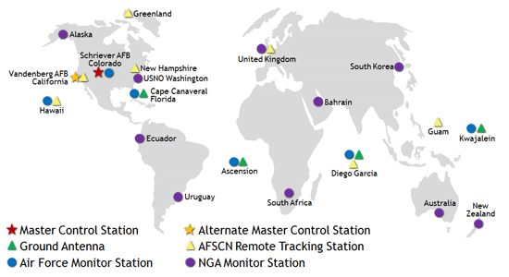
The GPS control segment consists of a master control station (and a backup master control station), monitor stations, ground antennas and remote tracking stations
The GPS control segment consists of a global network of ground facilities that track the GPS satellites, monitor their transmissions, perform analyses, and send commands and data to the constellation.
Control Segment Elements
Monitor Stations
Track GPS satellites as they pass overhead
Collect navigation signals, range/carrier measurements, and atmospheric data
Feed observations to the master control station
Utilize sophisticated GPS receivers
Provide global coverage via 16 sites: 6 from the Air Force plus 10 from NGA
Master Control Station
Provides command and control of the GPS constellation
Uses global monitor station data to compute the precise locations of the satellites
Generates navigation messages for upload to the satellites
Monitors satellite broadcasts and system integrity to ensure constellation health and accuracy
Performs satellite maintenance and anomaly resolution, including repositioning satellites to maintain optimal constellation
Currently uses separate systems (AEP & LADO) to control operational and non-operational satellites
Backed up by a fully operational alternate master control station
Ground Antennas
Send commands, navigation data uploads, and processor program loads to the satellites
Collect telemetry
Communicate via S-band and perform S-band ranging to provide anomaly resolution and early orbit support
Consist of 4 dedicated GPS ground antennas plus 7 Air Force Satellite Control Network (AFSCN) remote tracking stations
GPS control segment
Source: GPS.gov: Control Segment

Slide 35
Thank you

