Slide 1
Standards in Internet Technology Application
Instructions for attending courses and taking exams
academic year 25/26
Notes:
Ažurirati naziv kolegija.

Slide 2
Organization of lectures
Main lecturer: | Doc. Dr. Sc. Silvije Davila | sdavila@algebra.hr
Assistant: | Luka Postružin | Luka.Postruzin@algebra.hr
Class: | Lectures | 2 hrs/week: 30 hrs total
 | Workshops | 2 hrs/week - 30 hrs total

Slide 3

Info
5 ECTS points = 150 hrs of work
  30 hrs lectures
  30 hrs workshops
  90 hrs of individual work at home
Obligatory course
Notes:
Potrebno ažurirati podacima s Vašeg kolegija ovisno o broju ECTS-a na kolegiju.
Računa se da 1 ECTS bod označava oko 30 sati aktivnosti studenta (ukupna aktivnost u direktnoj nastavi i radu kod kuće).
Više u: SMJERNICE ZA IZVEDBU NASTAVE dostupne na Intranetu, str. 17

Slide 4
Goals of this class
To familiarize students with Standards in Internet –Technology Application.

Slide 5
About this class
100 pts in total:
  Project – 100 points
  Presence in class - 0 points

Slide 6
Learning outcomes
Group | Oucome | Minimum outcome | Optimal outcome
S1 | LO1 | Create a page structure according to a detailed specification. | Create a page structure using most appropriate HTML elements according to a detailed specification.
 | LO2 | Stylize page display. | Stylize page display using CSS transitions and transformations to achieve rich visual experience.
 | LO3 | Structure page display using client scripting. | Structure page display using external client scripting libraries.
 | LO4 | Apply standard client scripting libraries to manage page structure. | Apply standard client scripting libraries to manage page structure and responsiveness.

Slide 7
What will we learn?
Week | Lecture | Week | Lecture
1. | Introduction to HTML | 9. | JavaScript Introduction
2. | Create commonly used block and line elements | 10. | JavaScript objects
3. | Create forms | 11. | JavaScript prototype property
4. | Apply an HTML5 specification to forms | 12. | Apply a jQuery library
5. | Introduction to CSS | 13. | Access data from JSON objects
6. | CSS classes, working with position property | 14. | Applying jQueryUI library to create rich websites
7. | Define the structure of an HTML page by applying CSS | 15. | Apply bootstrap library to create responsive websites
8. | CSS transitions and transformations

Slide 8
Literature
ESSENTIAL READING
Robbins, J. (2018) Learning Web Design: A Beginner's Guide to HTML, CSS, JavaScript, and Web Graphics. 5th edn. Sebastopol: O'Reilly Media.
RECOMMENDED READING
McGrath, M. (2020) HTML, CSS & JavaScript in easy steps. Warwickshire: In Easy Steps Limited.

Slide 9
What is necessary to get a signature?
In order to obtain the right to a signature, it is necessary to participate in class at the percentage rate prescribed by the Book of Regulations on studies and studying.
Lectures and practical classes participation
At least 50% of physical presence in lectures | At least 60% of physical presence in practical classes
Whoever fails to obtain a signature will have to enroll in the same course the following year, to pay the enrollment and does not have the right to take the exam.

Slide 10

Taking a course
The course has defined 4 learning outcomes divided into 1 set of learning outcomes.
In order for students to pass a course, they need to achieve at least 50% of credits of the total credit amount within each of the learning outcome.
If students fail to achieve at least 50 % of credits of a learning outcome, they are required to take the learning outcome during the next exam period.
The learning outcome sets evaluation methods:
  Project Presentation (project defense)

Slide 11
How does this relate to learning outcomes
LO set | LO | Points
S1 | LO1 | 25
 | LO2 | 25
 | LO3 | 25
 | LO4 | 25
 | Out of LO | 0
 | Total | 100

Slide 12
Assessment
Number of points achieved | Grade
0,00 – 50,00 | 1 (insufficient)
50,01 – 58,00 | 2 (sufficient)
58,01 – 75,00 | 3 (good)
75,01 – 92,00 | 4 (very good)
92,01 – 100,00 | 5 (excellent)

Slide 13
Exams
Each course complies with the 3 + 1 rule.
  This means that a student can take an exam a maximum of 4 times.
    3 regular exams – included in the tuition fee
    1 extraordinary exam – 700 HRK for 4th registration of exam pursuant to the Decision on Reimbursement of Expenses
  The deadline for passing an exam is 12 months from the day of enrolment in the course.
  If a student fails to pass a course within 12 months, he/she must re-enrol in the course and re-take all learning outcomes defined in the course.
Keep track of deadlines for registering and cancelling exams on IE.
  If you failed to register an exam on time, you cannot take neither the written nor the oral exam.
  If a student registers for multiple examination periods of the same course, after obtaining a satisfying grade, he/she must cancel his/her registration for all subsequent examination periods of that course. Otherwise, an insufficient (1) will be recorded in Infoeduka for that student.
Notes:
Vrijedi za sve kolegije. Nije potrebno ažurirati.
Više informacija u PRAVILNIKU O STUDIJIMA I STUDIRANJU str. 9, dostupnom na Intranetu, te UPUTAMA O PROVOĐENJU ISPITA dostupnima na Intranetu.

Slide 14
Exams
Project course
The last deadline for submitting the project is at least 2 days before the exam due date
Take into account the deadlines for registration and deregistration of the exam at IE.
  In order for a teacher to be able to enter a grade, it is necessary to register for the subject in IE.
Important!! Encourage to work on the project during the course
  1st exam period = maximum of 100% points
  2nd exam period = maximum of 90% points
  3rd exam period = maximum of 80% points
  4th exam period = maximum of 70% points
Notes:
Vrijedi za kolegije projektnog tipa, ako se ne primjenjuje 3+1 pravilo. Projekt se može definirati kroz faze, ili na način da se odredi krajnji datum za predaju projekta. Detalje je potrebno opisati.
Ako nemate ovakav oblik provjere znanja, obrišite ovaj slajd.
Više informacija u PRAVILNIKU O STUDIJIMA I STUDIRANJU str. 9, dostupnom na Intranetu, te UPUTAMA O PROVOĐENJU ISPITA dostupnima na Intranetu.

Slide 15
Academic standard of conduct
  In written and oral communication it is necessary to follow the rules of business communication appropriate for the academic level.
  It is necessary to abide by the strictly defined deadlines for task submissions (homework, seminar papers, projects, etc…).
    Every task, homework, project etc…, submitted after the defined deadline will not be evaluated nor graded.
  Only those students who can confirm their attendance, will be considered as present.
    Signing other students, or registering their card is not allowed and may be subject to disciplinary action. The teacher will delete the student's attendance if he / she determines that the student is registered and is not present at the class.

Slide 16
Rules of conduct during class – in classroom
  One has to come to class on time.
  Upon entering the classroom, student registers for classes with a card and then sits in an accessible place for work.
  Disruption of class and inactive class participation is not allowed.
    Continuous breaking of this rule is sanctioned by reporting students to the Disciplinary Board.

Slide 17
Let's start!

Slide 18
HTTP HyperTextTransferProtocol
Information is transfered in form of a document (web page)
HTTP protocol – information is send and received in form of requests and responses.
Request has URL (Uniform Resource Locator) – specific address of web page
Server sends a list of headers before it sends a content of web page
Headers are instructions for browser how to interpret code of requested web page
Example request:
  Host: index.hr
Example response:
  Content-Type: text/html

Slide 19
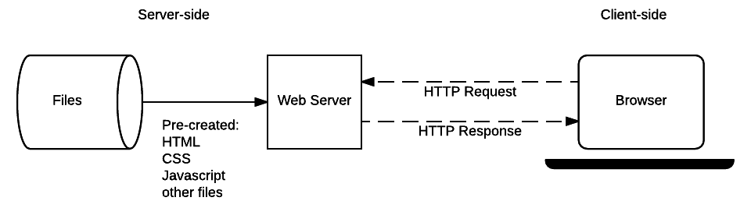
HTTP HyperTextTransferProtocol

Slide 20
HTML
HTML – HyperTextMarkupLanguage
  HyperText – clickable, interactive text. It allows users to jump from one page to other or from one position on some page to other position on the same page.
  Markup – Marks added to regular text
  Language – HTML is considered a markup language
1993. first, very limited version
1995 HTML 2.0, first standard version
1997 version 3.2, not revolutionary in any way, but introduced new elements into the specification that have already been supported by browsers, such as tables

Slide 21
HTML
Internet browsers did not implement HTML standard but use their own tags, and did not provide full support for HTML specification
A nightmare for programers and designers
  Multiple versions of web pages for different browsers
  Ignoring some browsers
1998 Web Standards Project brought some order by defining W3C* as a standard in writing HTML documents
  HTML Validator
By promoting browsers which implemented standard, they pressured Internet browser manufacturers.

Slide 22
HTML
Web Standards Project 1999 resulted by creating HTML 4.0
HTML 4.0 stabilized the language and became standard
On year 2000 W3C created XHTML 1.0, a standard which intended to replace HTML
XHTML (eXtensible HyperText Markup Language) is a set or rules and methodologies for XML which are usable on HTML
2001 XHTML 1.1
  Pages should be delivered with header:
  Content-Type:application/xhtml+xml
  “draconian error processing”
  poorly received by designers and programmers

Slide 23
HTML
Dissatisfied with the direction in which XHTML was being developed, a group of developers and browser manufacturers decided to develop HTML languages outside the W3C consortium
They formed a WHATWG* group that began further development of HTML under their own specification, which they called Web Applications 1.0
W3C acknowledged their work and accepted it in 2007 under the name HTML 5
HTML5
  compatible with previous versions of HTML
  supports new APIs
  introduces new semantic markup
*Web Hypertext Application Technology Working Group

Slide 24
HTML
HTML (Hyper Text Markup Language) a language to decribe web pages
It is not a programming language, but a markup language
With HTML we define structure of elements in a document (titles, paragraphs, images, hyperlinks...)
Allows us to determine the appearance of individual elements
Internet browsers do not display html tags but use them to interpret the content of a page

Slide 25
HTML
HTML tags are word in brackets<>, like <html>.
HTML tags are coupled : <b> </b>.
First one is opening tag, and second one is closing tag
HTML can be written in any text editor like Notepad ili Notepad++
Today, there are many tools that make it easy to write HTML code and work according to the WYSIWYG principle.
One of the most popular are Visual Studio Code, Sublime Text, Atom

Slide 26
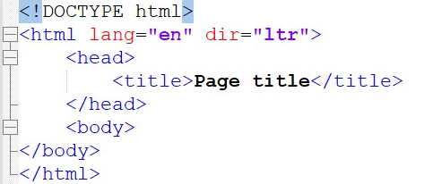
HTML elements
Main tag: <html>
Attributes:
  lang (ie. for date formatting)
  dir (in which direction should we write the page)
Mandatory <html> elements:
  <head> (header of document, content is not displayed in the browser, used to describe the page in detail)
    <title> (the title of the page that is printed in the title bar)
  <body> (content of the page, this will be displayed in the browser)

Slide 27
HTML elements
Two main groups:
  Block elements – take up the full width of their parent elements
    <div>, <p>, <table>, <hn>, <hr/>…
  Line elements – width is defined by the content
    <strong>, <em>, <span>…
Elements that do not have content, such as a horizontal line or a line break, do not have a closing tag
  <hr/>
  <br/>

Slide 28
Attributes
Some elements can’t be interpreted without attributes
Attributes are defined as name=”value"
Example of mandatory attributes:

Slide 29
Rules of writing HTML
Concepts of proper html code writing that should be adhered to for convenience:
  All attribute elements and names are written in lowercase letters
  All attribute values must be enclosed in double quotation marks
  All elements must be closed
  All elements must be properly nested
  Write a legible code
    at a first glance, the structure of the document must be clear (important if more than one person works with the same document)
  Comment on code

Slide 30
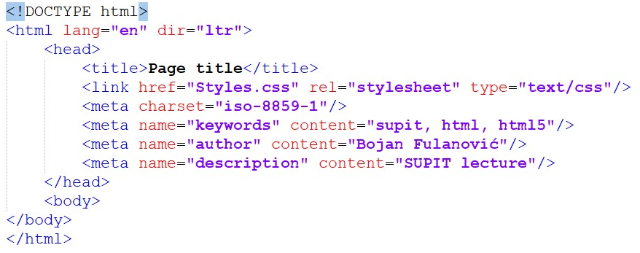
HTML tag <head>
Header of document – information for page rendering, title, browser info
Elements : <link>, <script>, <style>, <title>, <meta>
<meta> tag is for storing basic HTML data.
2 major attributes:
  charset (character encoding
  used in this document)
  name (name of the data defined under content)

Slide 31
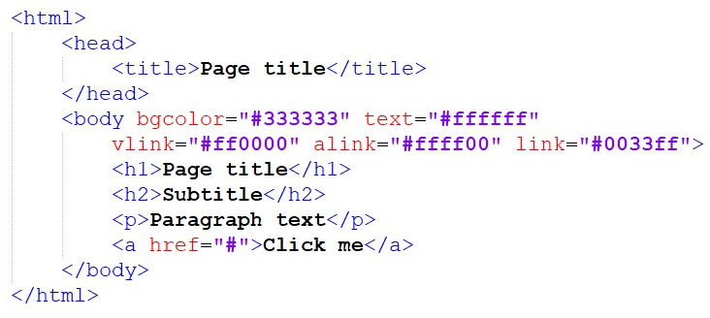
HTML tag <body>
Content of the page, it is the only thing that is rendered to the user
Attributes (supported up to HTML4.01 specification):
  alink – active link color
  vlink – visited link color
  link – unvisited link color
  background – background image
  text – text color
  bgcolor – background color

Slide 32
HTML tag <div>
Until HTML5 it was one of the most common way to group elements on web pages
Block element
Attributes (global – common to all HTML elements):
  id – identifier, unique name of the element
  title – aditionally describes the element, it is rendered as a tooltip
  style – to define inline style of an element
<div>Content of the div element</div>

Slide 33

HTML tag <p>
Commonly used block elements
Paragraphs can be defined with tags:
  <address> - it is italic by default
  <blockquote> - it is indented, used to print quotes
  <pre> - it uses fixed-width font and keeping spaces and new rows, usually used for code

Slide 34
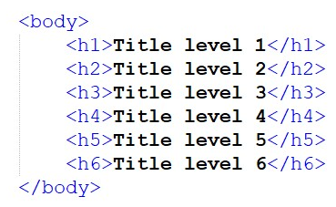
HTML tag <hn>
Represents the title of the block
It has 6 levels
  H1 - top level, larger font
  h6 – lowest level, smaller font
Attributes (HTML4.01 or earlier):
  align – of the text (left, right, center, justify)

Slide 35

HTML tag <img/>
Attributes:
  src – link to image
  border – border width
  hspace i vspace – pixel spacing from the text surrounding the picture
  align – top, middle, bottom, left, right
  alt – alternative text
  width width
  height – height

Slide 36
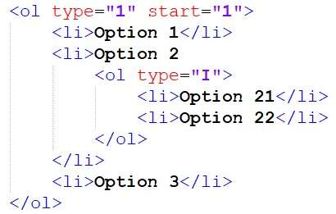
HTML tag <ol>
Used for hierarchy structure
  numeric
  simbolic
Ordered list <ol>
  Elements of ordered list are marked by numbers or letters
<ol> attributes:
    type - (1, a/A, i/I)
    Start

Slide 37
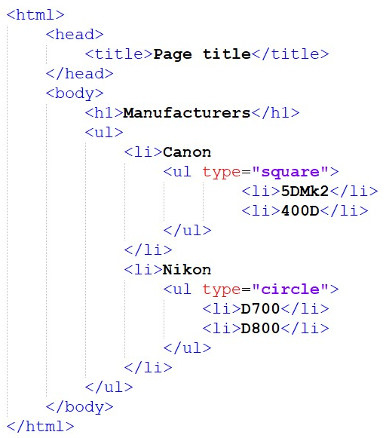
HTML tag <ul>
<ul> attributes:
  type
    disc – full circle
    square – full square
    circle - circle
<li> attributes:
  type
    disc – full circle
    square – full square
    circle - circle

Slide 38
HTML tag <a>
Attributes:
  href – link to the document
  target – window in which the document will open
    _self – same window
    _blank – new window
    some_name – new window, all links with the same target name will open in the same window

Slide 39
HTML tag <a>
4 types of tags:
  Internal links– relative adresses between pages of same site
  External links – absolute adresses to some other sites
  E-mail links – use this as an URL: mailto:some@address.com
  In-page links– links to anchors

Slide 40
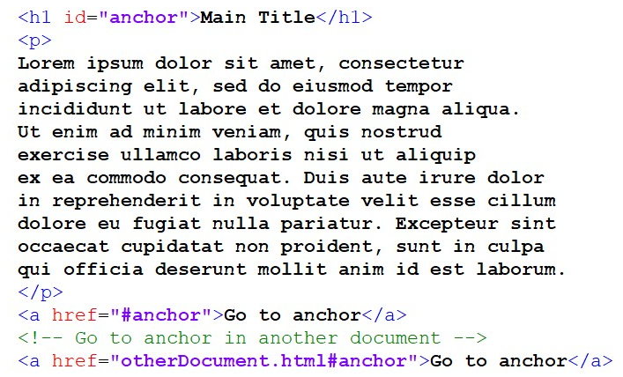
Anchors

Slide 41
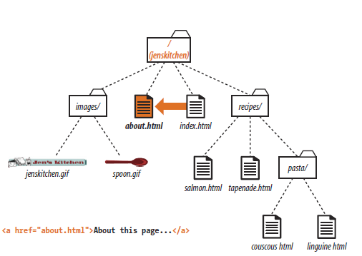
Links in the same directory

Slide 42
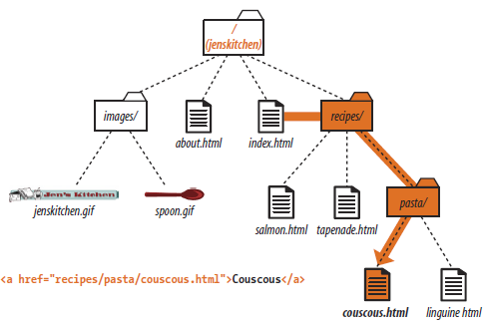
Links to lower level documents

Slide 43
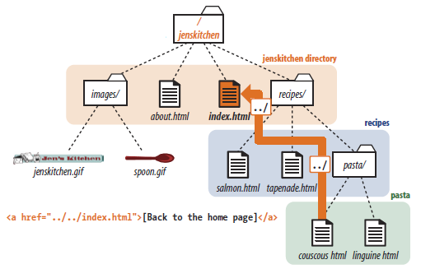
Links to higher level documents

Slide 44
HTML special symbols
Symbols must begin with ampersand (&), and end with semicolon (;)
  &copy; &lt; &gt;
  http://www.ascii.cl/htmlcodes.htm
Any sign or simbol can be written in the same way but it is not necessary.
  ie. Symbol @ can be written as &#64;

Slide 45
Thank you for your attention!

