Slide 1
Standards in Internet Technology Application
Lecture 02

Slide 2
Table
Structural block elements which contains cells. Cells can contain text, images, lists, paragraphs, horizontal lines or other tables.
They are developed out of a need for a way to present structured data – in finance, statistics, reports...
Until a few years ago, it was common practice to use tables as a layout tool for more complex web pages.
From specification: Tables should not be used as layout aids. Historically, many Web authors have tables in HTML as a way to control their page layout making it difficult to extract tabular data from such documents. In particular, users of accessibility tools, like screen readers, are likely to find it very difficult to navigate pages with tables used for layout.

Slide 3
Element <table>
Attributes (html 4.01):
  border (0 or 1 – the value determines whether the border is displayed)
  width (of the table)
  bgcolor (background color of the table)
  summary (additional description, table summary)
  cellspacing (horizontal and vertical spacing between cells)
  cellpadding (horizontal and vertical spacing between cell’s border and content)
  frame (which part of border is visible [above, below, hsides, vsides, lhs, rhs, box/border, void]
  rules (which part of the grid will be visible [rows, cols, groups, none, all]
Attributes (html5):
  border (0 ili 1 – the value determines whether the border is displayed)

Slide 4
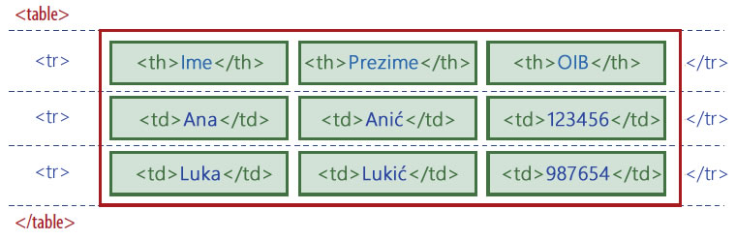
Element <table>
Rows of the tables can be grouped in Header, Body, and Footer using tags:
  <thead>
  <tfoot>
  <tbody>
Body can be displayed independent of header and footer
When you print long tables, the header and footer are printed on each page

Slide 5
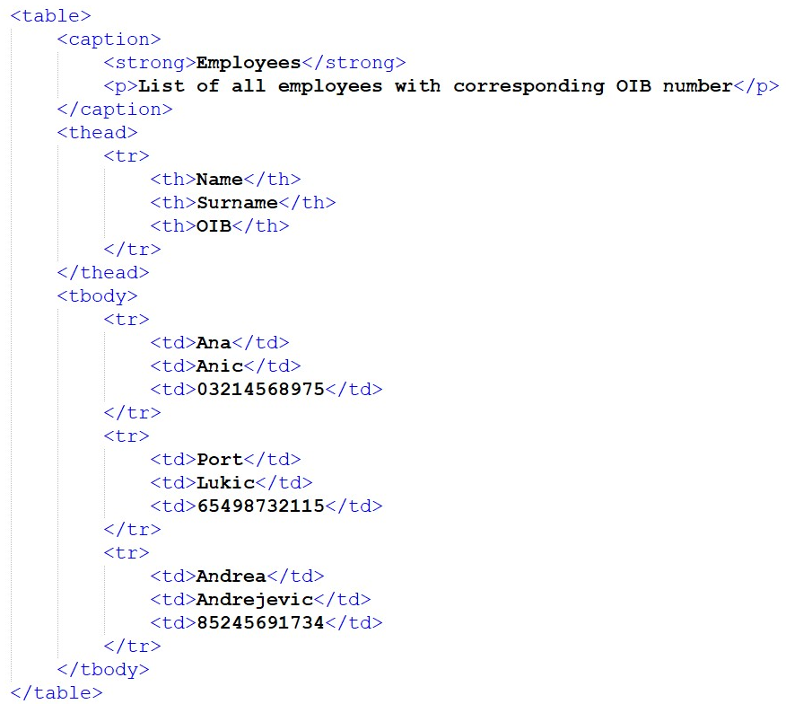
Example:
Notes:
Example-2-1
- Uncomment <caption>

Slide 6
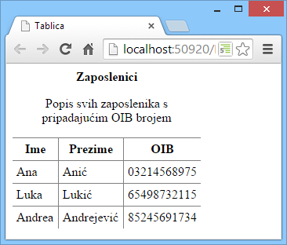
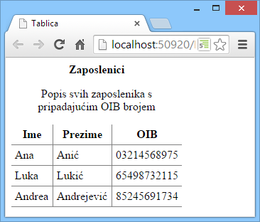

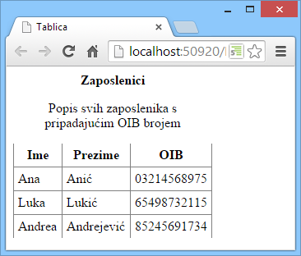
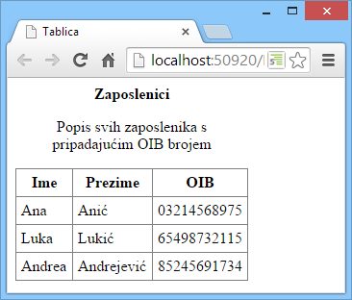
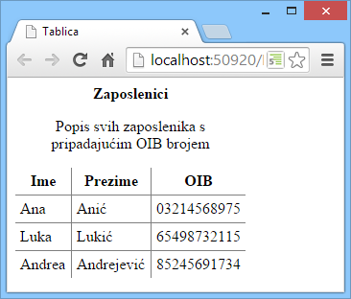
Attribute frame
  frame (which part of frame is visible [above, below, hsides, vsides, box/border, void])
frame="abow"
frame="below"
frame="hsides"
frame="vsides"
frame="border/box"
frame="void"
Notes:
Example-2-1
- Use <table frame="…"> to show frame

Slide 7

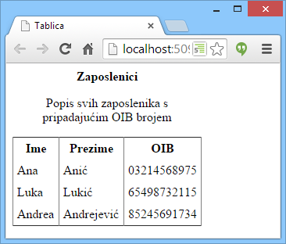
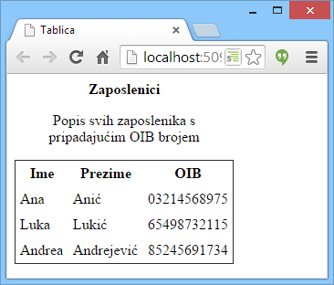

Attribute rules
  rules (which part of grid is visible [rows, cols, groups, none, all])
rules="rows"
rules="cols"
rules="none"
rules="all"
rules="groups"
Notes:
Example-2-1
- Use <table frame="…" rules="..."> to show rules

Slide 8
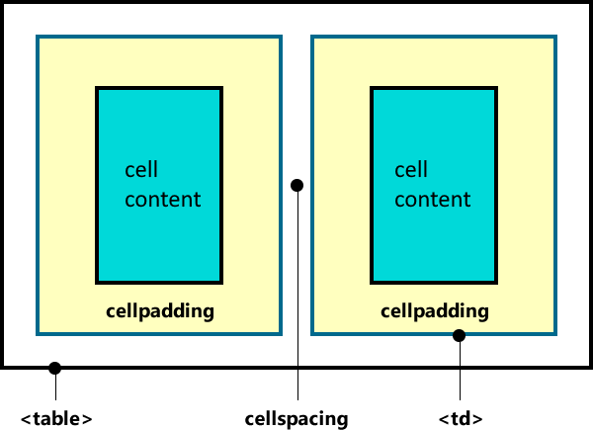
Visualization of cellspacing and cellpadding attribute

Slide 9
Elements of <table> tag
<caption>
  Title of the table
  First and topmost element of the table
  Table can have only one caption
  Is usually of a general meaning and should be further clarified with the summary attribute
<colgroup>
  It goes after caption element and before thead, tfoot i tbody elements
  It is a group of one or more columns
  We use it to apply style to more than one collumn at a same time
  It groups elements structuraly
  Attributes: width, span
Notes:
The COL does not group columns together structurally -- that is the role of the COLGROUP element. COL elements are empty and serve only as a support for attributes

Slide 10
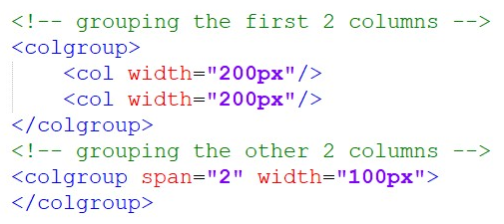
Elements of tag <table>
<col>
  Used for applying attributes to collumns
  It DOESN’T group columns
  It can be nested in colgroup elements
Notes:
The COL does not group columns together structurally -- that is the role of the COLGROUP element. COL elements are empty and serve only as a support for attributes
Example-2-1
- Uncomment <colgroup> tags

Slide 11
Element <tr>
  id - identifier
  title – title of the element
  style – inline style
  align – horizontal alligment of content (left, center, right)
  valign – vertical alligment of content (top, middle, bottom)
  bgcolor – background color of the row

Slide 12
Elements <th> and <td>
<th> used for title cells. Text is bold and centered
<td> used for standard cells
Attributes:
  align – horizontal alignment of content (left, center, right)
  valign – vertical alignment of content (top, middle, bottom)
  bgcolor – cell’s background color
  colspan – merges cells in a row, defined in number of cells to be merged
  rowspan – merges cells in a column, defined in number of cells to be merged

Slide 13
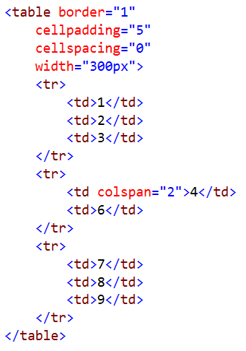
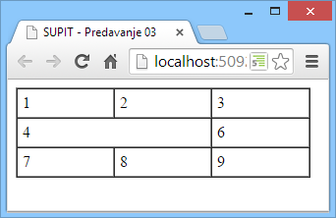
Merging cells - colspan
Notes:
Use generator:
https://www.quackit.com/html/html_table_generator.cfm

Slide 14
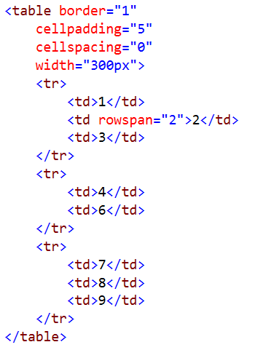
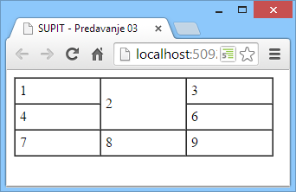
Merging cells - rowspan

Slide 15
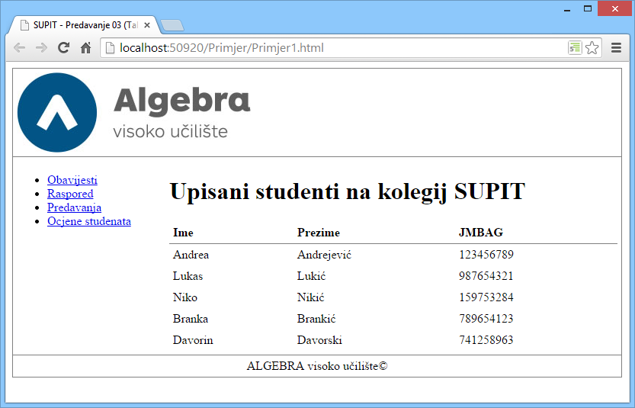
Using tables to structure web page
For practice only, do not apply in production!

Slide 16
Thank you for your attention!

