Slide 1
Standards in Internet Technology Application
Lecture 03

Slide 2
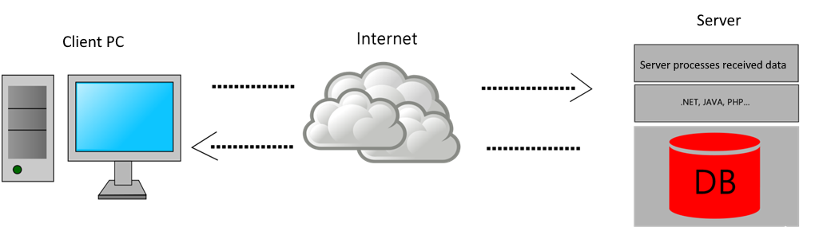
Forms
Interactive forms allows as to receive various information from web page visitors.
In essence, their format is similar to real-world forms; procedure for creating them is very simple.
User inputs the data in input fields inside the form.
When finished, data is sent to server-side script.
Server receives data and executes an action or set of actions.
Notes:
Post metode ne mogu prikazati jer IIS handler zaključuje prema putanji da okidaju html fajlu (static file), a on nije u stanju obraditi post zahtjev.

Slide 3
Forms
Creating a form consists of 2 parts:
  Creating a visible part filled in by a visitor
  Create an invisible part, a program or a script that determines how the data entered in the form will be processed
Forms are a separate part of web page, usually defined as a separate segment or even as a separate page.
It contains different types of fields that allow interaction, such as text input fields, drop-down menus, radiobuttons, checkboxes and buttons.
One web page can have multiple forms.

Slide 4
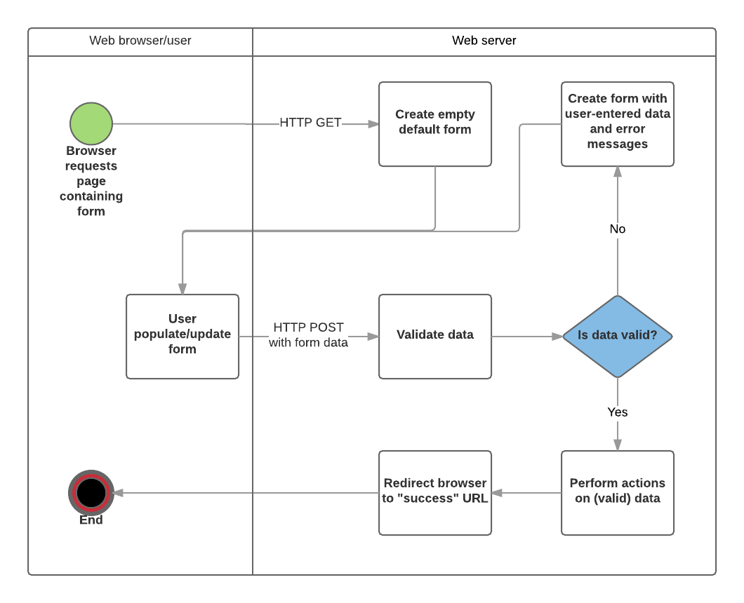
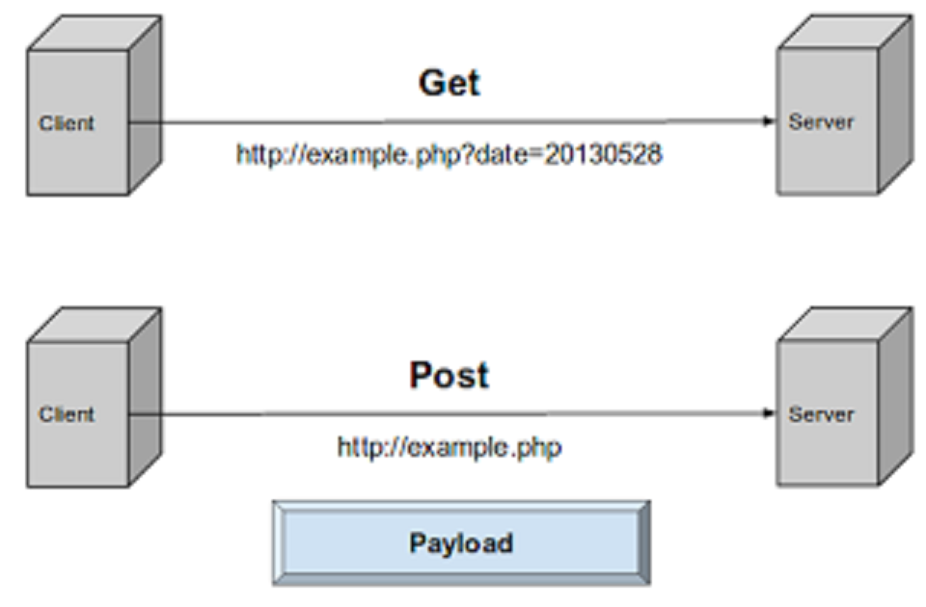
Forms – real world example

Slide 5
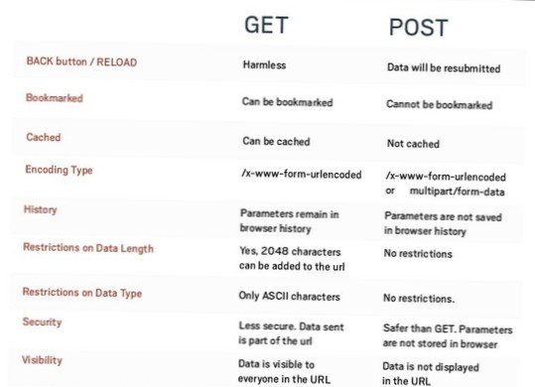
Forms – real world example

Slide 6
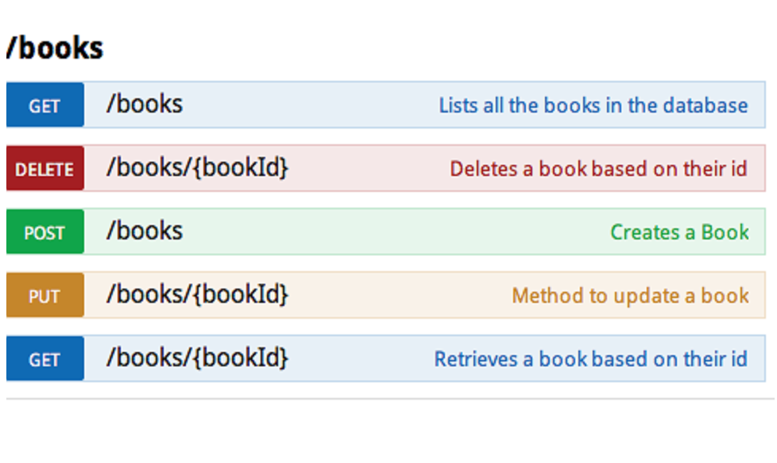
Forms – real world example

Slide 7
Forms – real world example

Slide 8
Element <form>
It defines a form
Represents a container for all form elements
It musn’t contain other <form> tags
To allow interaction with server, following attributes are reqired:
  action – URL path to the server side script
  method - http method user for sending data to the server side

Slide 9
Attribute method
For example, let asume we are sending following data:
  Username=John
  Email=john@mail.hr
After the browser encodes the data to send (GET) it to the server, it looks like this:
  username=Pete&email=pete%40mail.hr
Form data is encoded in the same way the URL addresses are encoded. Forbiden characters are transscripted into their hexadecimal equivalents:
  space: %20
  @: %40
  /: %2F

Slide 10
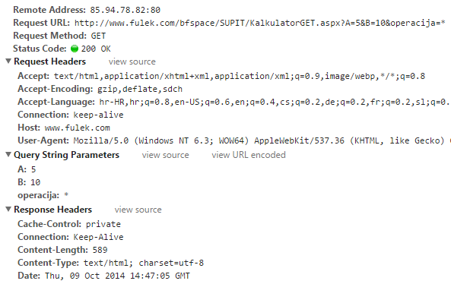
Attribute method="GET"
Data can be sent by using GET and POST methods
  GET
    Default way
    Limited data capacity
    Data is send via URL address
    They are not suitable for sensitive information such as PIN, passwords, etc.

Slide 11
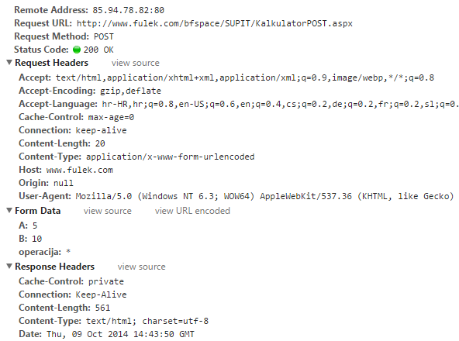
Attribute method="POST"
Data is not visible to the user
Data is sent in http body after http headers

Slide 12
Attribute name
Puprose of every form is to gather data from the users
Data is stored in parameters (variables)
The name attribute represents the name of the parameter for the control (tag) on which it was applied
User input will be value of that parameter
Parameter naming must be consistent with the server script

Slide 13

Element <input type=" text ">
By using <input> element it is possible, depending on type attribute, to define a several different types of form controls.
type:
  text – defines a text field
    name – parameter name
    value - initial text
    maxlength – maximum number of characters
  password – input field for passwords

Slide 14
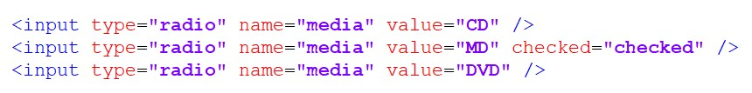
Element <input type=" radio ">
Type:
  radio – defines the radiobutton menu, using it we enable the visitor to choose only one option from the offered list
    Elements can be grouped by by defining the same value of the name attribute
    When grouped, radio button values are mutually exclusive

Slide 15

Element <input type=" checkbox ">
Type:
  checkbox – multiple choice control
    Elements can be grouped by by defining the same value of the name attribute
    User can opt to select more than one option at the same time
    Every selected option will be sent to the server side script

Slide 16

Element <input> - a button
type:
  submit – defines a button that sends form data to a server script
  reset – resets form elements to their initial values
  button – defines a button whose functionality needs to be further programmed

Slide 17

Element <input type="file">
The enctype attribute specifies how the form-data should be encoded when submitting it to the server
The enctype attribute specifies how the form-data should be encoded when submitting it to the server
The enctype attribute specifies how the form-data should be encoded when submitting it to the server
In addition to the usual controls, the form also offers a control for sending files to the server (business files, photos, etc.)
How the form should be submitted to the server (encoded)
A form that has this type of control must be defined by an attribute enctype="multipart/form-data"

Slide 18
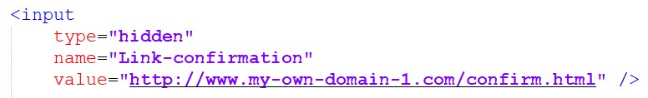
Element <input type="hidden">
For creating hidden key-value pairs
Invisible to the users

Slide 19
Element <textarea>
Used in places where a larger amount of text is provided
  rows – text field height, number of lines specified
  cols – text field width, number of characters specified
<textarea id="txtComment" name="comment" rows="20" cols="50">
Enter a comment here...
</textarea>

Slide 20
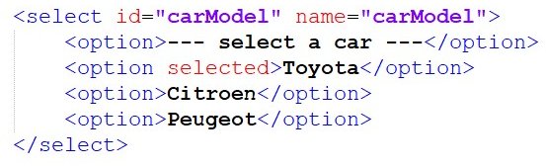
Element <select>
Drop down menu
Used when we want to allow the user to select one option

Slide 21
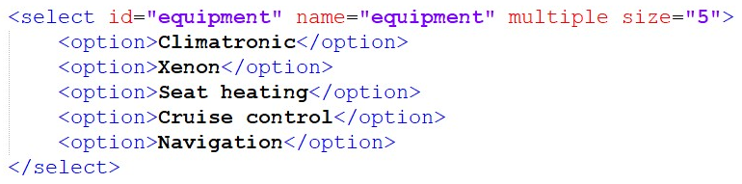
Element <select>
If we want to allow selection of the multiple options, the attribute multiple must be used
To show drop down menu as a list box menu, use attribute size with the number of options shown

Slide 22
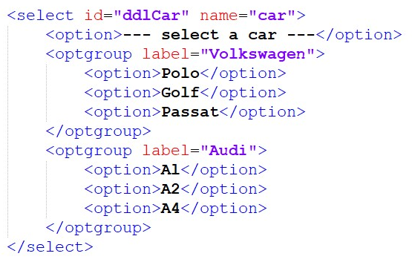
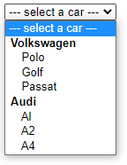
Element <select>
You can group elements of drop down menu by tag <optgroup>

Slide 23
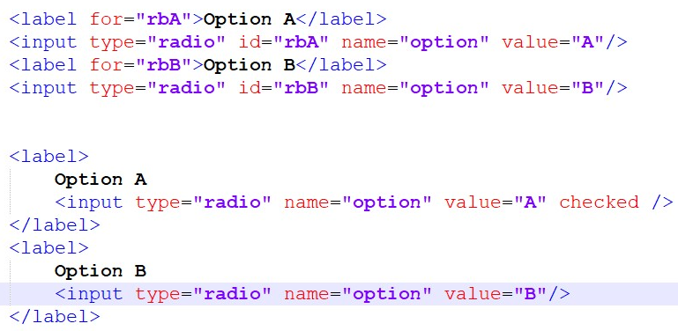
Element <label>
It is used to create the corresponding input label of the element.
Clicking on the label element focuses the input element to which it binds using the for attribute
Another way to achieve the identical functionality is to set the radiobutton as the value of the label element

Slide 24
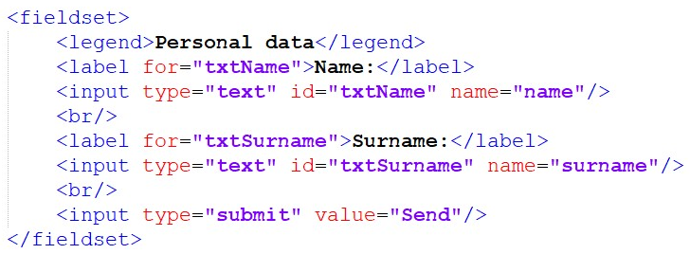
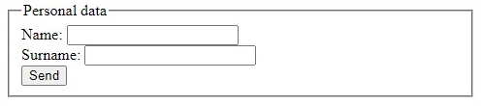
Element <fieldset>
Logical grouping of form elements
Draws a border around enclosed elements
To set a name for the group, use tag <legend>

Slide 25
HTML5 elements of <form>
HTML5 adds new attributes to form elements that increase their interactivity:
  validation
  placeholder
  autofocus
  autocomplete
HTML5 adds new types of input elements
  email
  numeric
  url
  date
HTML5 adds new form elements:
  <datalist>, <progress> and <meter>

Slide 26
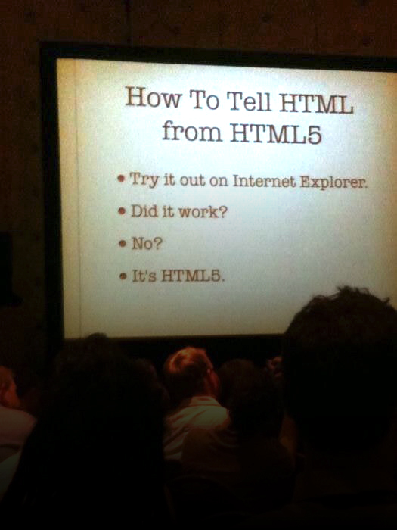

Slide 27
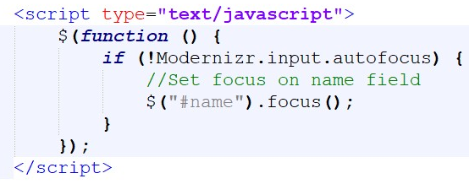
HTML5 form elements
Internet search engines that don't support new HTML5 tags and attributes simply ignore them
If we want to check search engine support for new HTML5 elements we can use javascript library Modernizer
http://modernizr.com/download/
Modernizr allows us to make our own implementations of HTML5 properties if the browser does not support them already

Slide 28
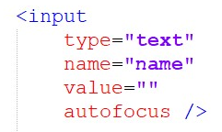
Attribute autofocus
Form control with autofocus attribute defined will be given focus after the page loads
Just one control in one html document should have that attribute. If multiple control have the autofocus attribute, just first one is given the focus

Slide 29
Attribute autocomplete
Internet search engines on text fields offer values that have been entered previously
This behavior can be controlled by an autocomplete (on/off) attribute
  Cannot be applied to password input control
Autocomplete allows the browser to predict the value
Internet search engines in their settings offer to turn on this option

Slide 30
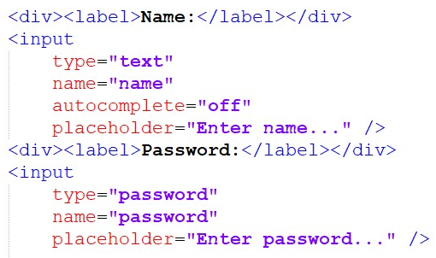

Attribute placeholder
Represents a hint of what is the purpose of a text field
It is not intended to replace the text field related label
Displayed to the user when the control is empty and is not selected

Slide 31
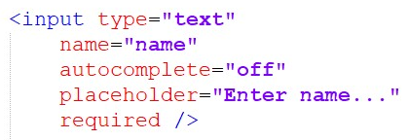

Attribute required i novalidate
required attribute specifies that control must be filled by user
By clicking on the submit button, it is checked whether the control has a value entered
  form must not have a novalidate attribute defined
Does not verify that the value is correct
Form attribute, novalidates, allows the form to avoid validation before submitting

Slide 32
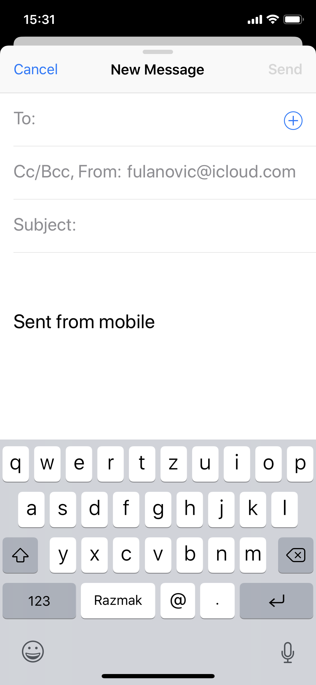
Attribute <input type="email"/>
A field for email address
Validation will check if the email address is in a correct form
On devices with virtual keybords, a specialized keyboard will be shown

Slide 33
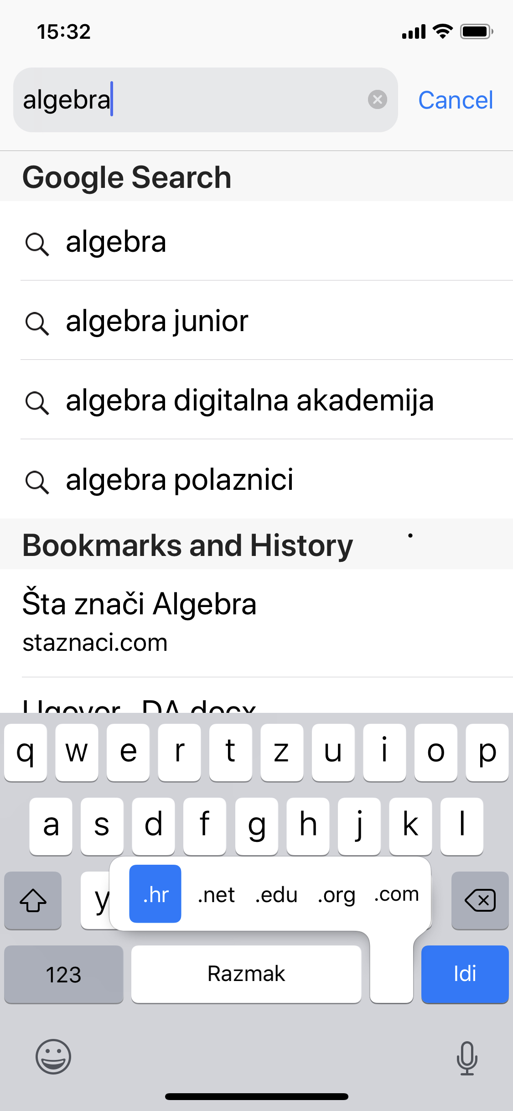
Attribute <input type="url"/>
Input field for web addresses
Validation will check if input is a web address
On devices with virtual keyboards, a specialized keyboard will be shown

Slide 34
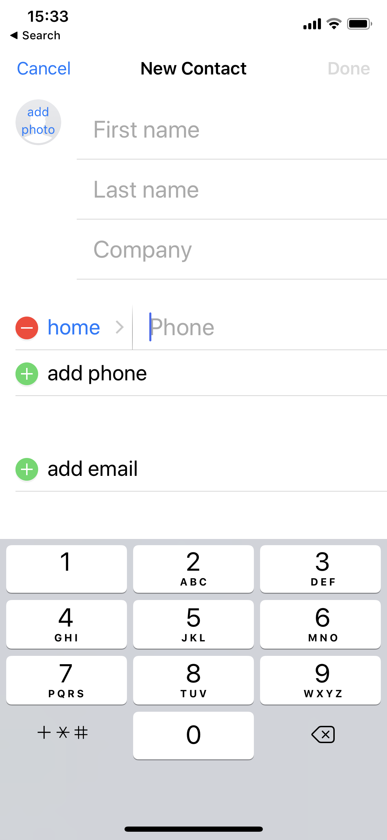
Attribute <input type="tel"/>
A field for telephone number
It is not validated due to the large number of phone number standards
On devices with virtual keybords, a specialized keyboard will be shown

Slide 35
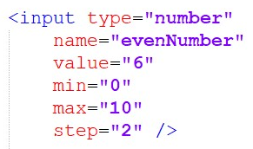

Attribute <input type="number"/>
Input field for entering numbers
Validation will check if a value is indeed a number
On devices with virtual keybords, a specialized keyboard will be shown
Additional interactivity can be achieved by using attributes min, max and step

Slide 36
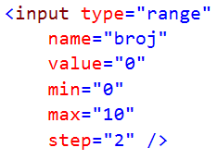
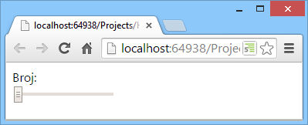
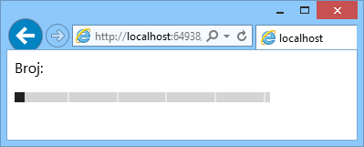
Attribute <input type="range"/>
Input field for a number in a cerain range
Validation will check if number is in a defined range
Additional interactivity can be achieved by using attributes min, max i step

Slide 37


Element date i color
date input type is control for picking a date
Different variations can be achieved by using different types:
  time
  datetime-local
  month
  week
color input type is a control for color picking ☺

Slide 38
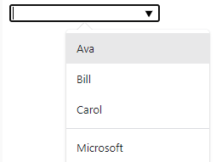
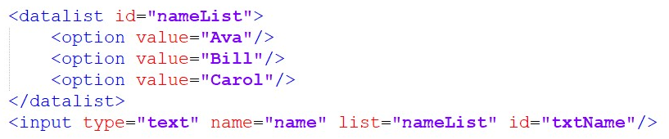
Element datalist
A data collection that can be used for input text fields
User can enter some custom value, it doesn’t have to one from data collection
To connect it with the input field, use list attribute

Slide 39

Element progress
Represents a progress bar for solving a task
  ie. Process of registration of users, step 2 of 5
Attributes:
  value – current value
    step in solving the task
  max – number of steps required to solve a task

Slide 40

Element meter
Represents a value in a specific range
You can think about it as a counter – ie. Capacity of HDD
Attributes:
  min – minimum value
  max – maximum value
  optimum – a point where value can be considered optimal
  low – represents the point to which values are considered low
  high – represents the point from which values are considered high
  value – current value

Slide 41
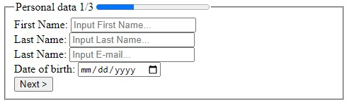
Example – Form1.html
Create a form according to the image shown.
All fields are required.
E-mail address must be entered correctly
The Name field is selected after the page is loaded
Clicking the Next button sends the data to Form2.html by using get method

Slide 42
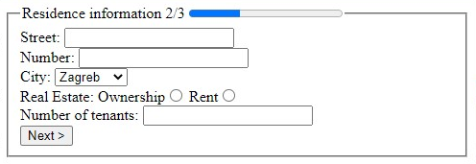
Example – Form2.html
Create a form according to the image shown.
The Number field must be a numeric value greater than 0
The First and Last name (John Smith) are stored in hidden fields
The No. of tenants field offers a range of numbers from 1 to 5 and should not suggest previously entered values
Clicking the Next button sends the data to Form3.html using the get method

Slide 43
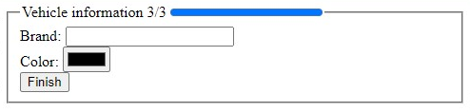
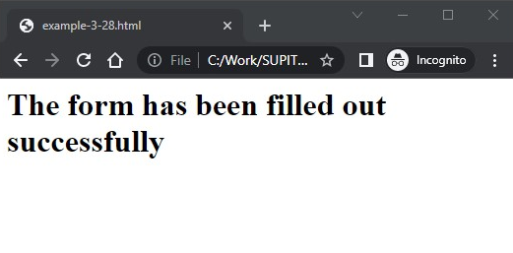
Example – Form3.html
Create a form according to the image shown.
The Brand field must not suggest previously entered values.
Clicking the Next button sends the data to the Finish.html using the get method

Slide 44
Thank you for your attention!

