Slide 1
Standards in Internet Technology Application
Lecture 04

Slide 2
Introduction to CSS
CSS (Cascading Style Sheet) serves to improve the appearance and to position and design elements of the website
Unlike the scant attributes of HTML elements, CSS offers the following advantages:
  Multiple ways to define a page layout
  The ability to set the background image of a page
  unlike HTML presentation tags CSS takes up much less space
  makes it easier to maintain the page
    changing a style changes it on all pages where it is applied
  The first version was released in 1996 (CSS 1.0), and the version used today and considered standard is CSS 2.1 (specification was published in 2004)

Slide 3
Web pages as layers
Content: The foundation layer
Structure: HTML
Presentation: CSS
Behavior: JS
Each layer enhances the base content in some way

Slide 4
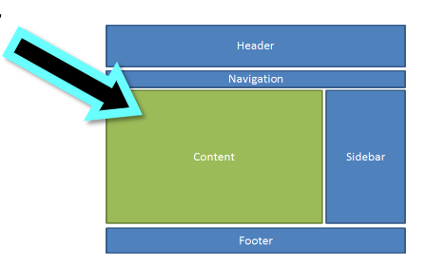
Why do we use CSS
Formatting
  Fonts, colors, background, borders, etc
Layout
  Positioning the content
  Columnar layouts

Slide 5
Short History
Before:
  Used for years for Desktop Publishing
  Apply typographical styles and spacing for prints
Now:
  Every webpage
  Flexible cross platform standardized language developed by W3C

Slide 6
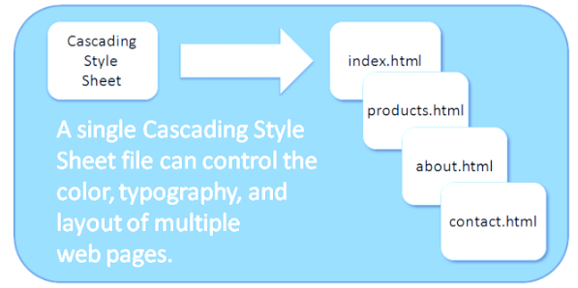
Advantages
Separation of concerns
  Style is separated from structure
CSS is often stored in an individual file and associated with html files
Easy to maintain

Slide 7
Browser loading/accessing the CSS
External CSS file
  Separated text file that has .css extension
  We link it in HTML file in head section
Embedded CSS
  Inside <style></style> block in the head section of HTML
  Applies to body of that file
Inline CSS
  HTML attribute
  Applies to that HTML element only

Slide 8
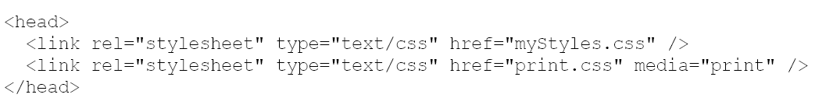
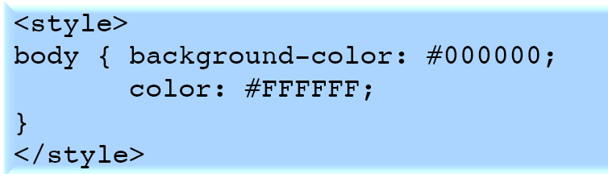
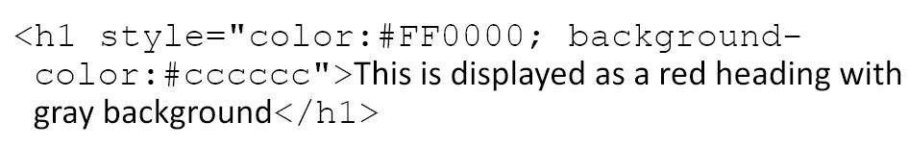
Browser loading/accessing the CSS
External CSS file
  Separated text file that has .css extension
  We link it in HTML file in head section
Embedded CSS
  Inside <style></style> block in Applie
Inline CSS
  HTML attribute
  Applies to that HTML element only

Slide 9
Browsers have default CSS
Every browser is loading their own CSS on your webpage
You actually overwrite those rules with your rules
Not a lot of rules but there are some
Font sizes, font family, font color, background color, etc…

Slide 10
CSS selectors
Selector represents a set of html tags
Generic example of defining the appearance of selectors (tags):
selector { property:value; }
In the declaration block, we determine the CSS properties of the selectors in all places within the website where it appears
Property
  For example, for font size: font-size.
Value
  For example, 2em

Slide 11
CSS selectors
CSS styles can be applied in three ways:
  as line styles
  as styles within a <style> tag
  as styles in an external file

Slide 12
Line Styles
Assigned as style attribute values
<p style="font-family:Arial; ">
I am a paragraph
</p>

Slide 13
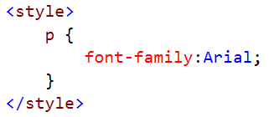
Styles within <style> tag
They are ownership of the html document in which they are defined
They're bad for defining a style on a web application-level

Slide 14

Styles in an external file
The best way to define styles
  the file can be linked to any website
  allows you to define the design of an entire web application within a single file
  allows you to load the website faster
    html does not contain CSS
    css file is cashed on client computer
  html connection mechanism
  css connection mechanism

Slide 15
CSS – font size
The unit of measurement can be expressed in:
  em
  px
  keywords (…, small, medium, large, …)
  %
em, % and keywords are adjusted against browsers base-font (IE, Chrome:Times New Roman, 16px)
base-font: 1em, medium, 100%

Slide 16
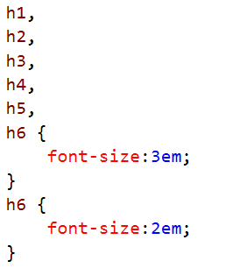
Grouping of selectors
If there is a need to style several different html elements in the same way

Slide 17
CSS inheritance
Inheritance is a process in which CSS properties applied to the parent element are also applied to elements of children
  For example, the label <p> is always nested inside the <body> tag. So all properties applied to the <body> tag also apply to the <p> tag
Inheritance is applied to multiple generations
Inheritance speeds up page styling process
Properties that affect element positioning, margins, background colors, and frames are not inherited
<body style="font-family: Arial; ">
<p>
I am <strong>paragraph</strong>
</p>
</body>

Slide 18
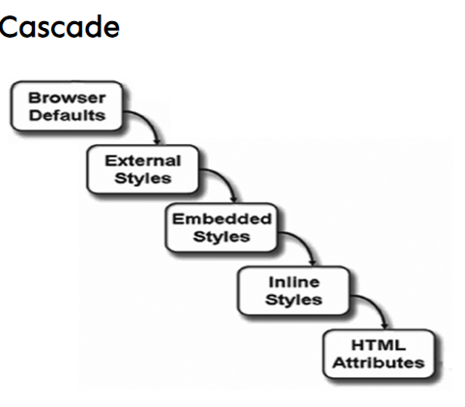
CSS inheritance

Slide 19
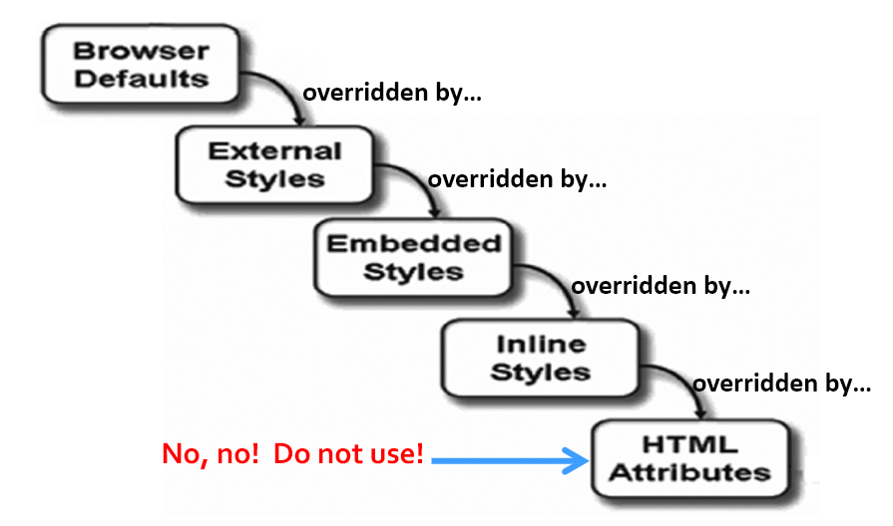
CSS inheritance and priority

Slide 20
Pseudo classes
When we need to edit parts of the site that do not have separate tags we use pseudo classes
  e.g. display a link by mouse hovering
4 pseudo classes which can define the appearance of the link:
  a:link – Unused link layout
  a:visited – The appearance of the already visited link
  a:hover – Link layout when hovering the mouse over it
  a:active – Link layout while clicking with the mouse
They must be specified in this exact order in order to function properly

Slide 21
CSS Classes and rules
selector {
font: 2px;
color: #fff;
}
You can make a custom selector which is called class or ID
In html we apply a class/id to html elements and use it as selector in CSS

Slide 22
Basic text editing properties
The color property is used to determine the color.
Property value:
  hexadecimal value
  RGB values
  keywords:

Slide 23
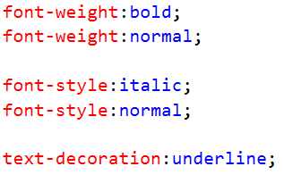
Basic text editing properties
Bold, oblique, and underlined text (<b>, <i>, <u>)

Slide 24
Basic text editing properties
The font-family property is used for font type
When choosing a font, one should bear in mind that the client will display the declared font only if it is installed on the client system.
To ensure the most similar look, our web application should specify more than one similar font (font-stack) when defining the font
The browser will display the first installed font it encounters
The declaration of multiple font properties can be abbreviated:
The last two properties must be font size and font type (in that order)
Other elements shall be indicated arbitrarily

Slide 25
Basic text editing properties
/*UPPER CASE*/
text-transform: uppercase;
/*LOWER CASE*/
text-transform: lowercase;
/*CAPITALIZES FIRST LETTER OF THE WORD*/
text-transform: capitalize;
/*UNDERLINES AND STRIKES OUT*/
text-decoration: underline;
text-decoration: line-through;
text-decoration: none;

Slide 26
Basic text editing properties
/*SPACE BETWEEN LETTERS*/
letter-spacing: 10px;
/*SPACE BETWEEN WORDS*/
word-spacing: 2px;
/*SPACE BETWEEN LINES*/
line-height: 1.5em;

Slide 27
Basic text editing properties
/*TEXT ALIGNMENT*/
text-align:center;
/*INSERT THE FIRST LINE*/
text-indent: 25px;
/*SPACE BETWEEN ELEMENTS*/
margin:0;
margin-top:0;
margin-right:0;
margin-bottom:0;
margin-left:0;
margin:0 0 0 0;

Slide 28
Basic text editing properties
/*SPACE BETWEEN CONTENT AND ELEMENT EDGE*/
padding:0;
padding-top:0;
padding-right:0;
padding-bottom:0;
padding-left:0;
padding:0 0 0 0;

Slide 29
Basic text editing properties
/*ELEMENT BORDER*/
border-width: 1px;
border-style:solid;
border-color:#ccc;
border:1px solid #ccc;
/*BORDER OF CERTAIN ELEMENT SIDES*/
border-top-width:2px;
border-top-color:red;
border-top-style:dashed;
border-right:2px solid #30;
border-bottom:2px dotted blue;
border-left:2px solid #333;

Slide 30
Background Image
We can set the background image to each HTML element
Setting the background image (gif, jpg, png):
  background-image: url(images/bg.gif);
  background-repeat:
    no-repeat
    repeat – predefined value
    repeat-x
    repeat-y
  background-attachment:
    scroll – initial state
    fixed
  background-position (starting point of the image, applicable if background-repeat:no-repeat):
    left top, left center, left bottom…
background:url(image.jpg) #333333 repeat-x;

Slide 31
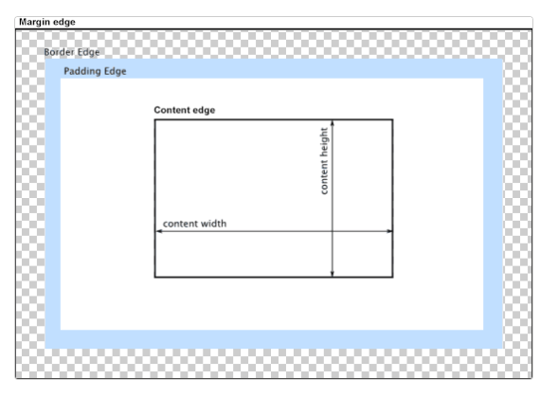
Box model
CSS treats HTML elements
as boxes

Slide 32
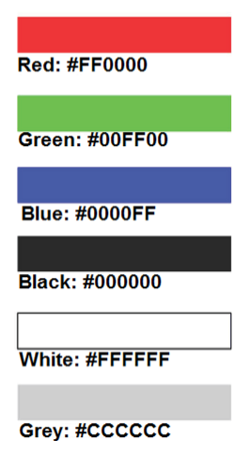
Tips and tricks
No spaces between value and units
  font-size: 5px;
  font-size: 5 px;
Colors on web
  RGB
  Values from 0 to 255
  Hexadecimal numbers

Slide 33
Tips and tricks
Units
  Absolute
  Relative
  Keywords

Slide 34
Tips and tricks
Units
  Absolute
    Absolute only if device has enough resolution
    Variations exists between devices
    Inches, cm, mm, px, pt
  Relative
  Keywords

Slide 35
Tips and tricks
Units
  Absolute
    Absolute only if device has enough resolution
    Variations exists between devices
    Inches, cm, mm, px, pt
  Relative
    Relative to something, often default values
    ems,%
  Keywords
    Medium, large, green, solid, dotted
    Many other…

Slide 36
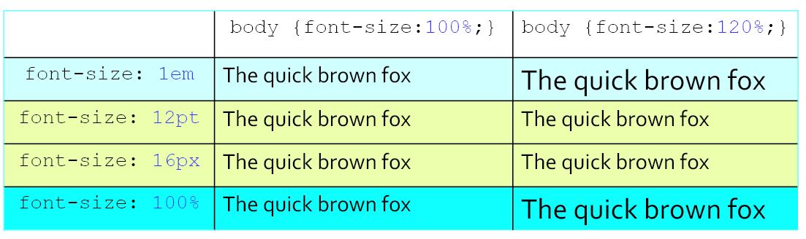
Tips and tricks

Slide 37
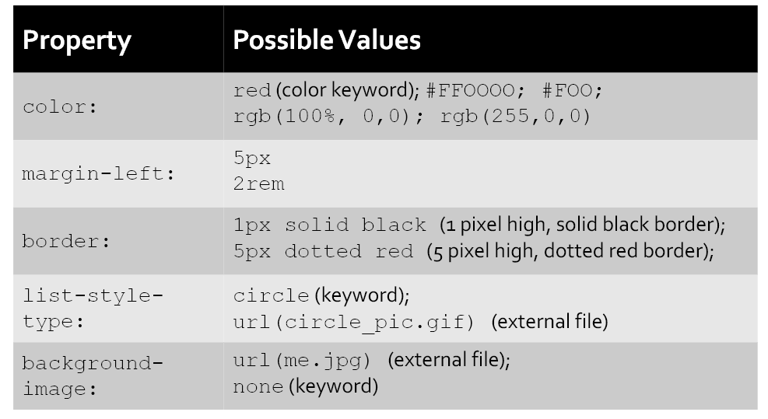
Tips and tricks

Slide 38
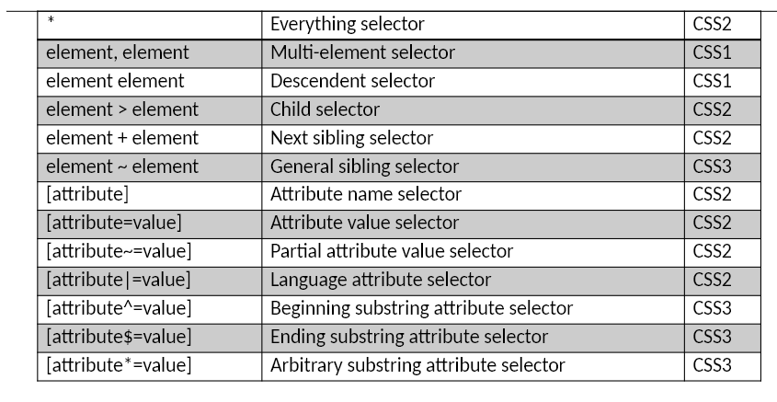
Tips and tricks: Very Important!

Slide 39
Thank you for your attention!

